Slide 1


Everyone Can Play!
Building CTFs for Non-Security Folks
APRIL 2025
Joe Kuemerle
@jkuemerle@infosec.exchange
www.owasp.org

Slide 2
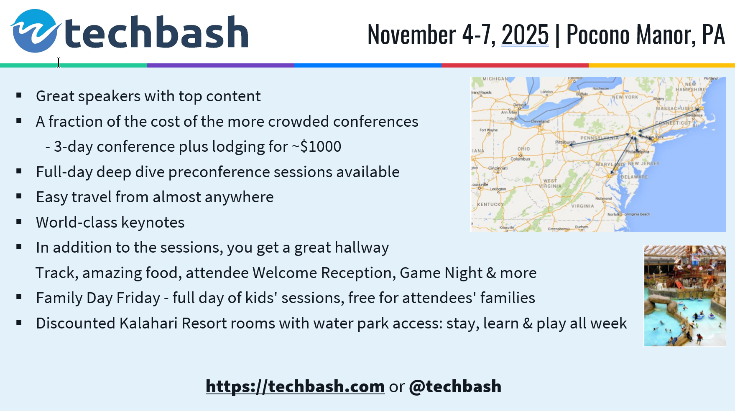

Slide 3


Agenda
Why
Learning studies
Proven success
What
Building challenges
Easy to participate
Fun
How
Easy to run
Measured
|
‹#›

Slide 4
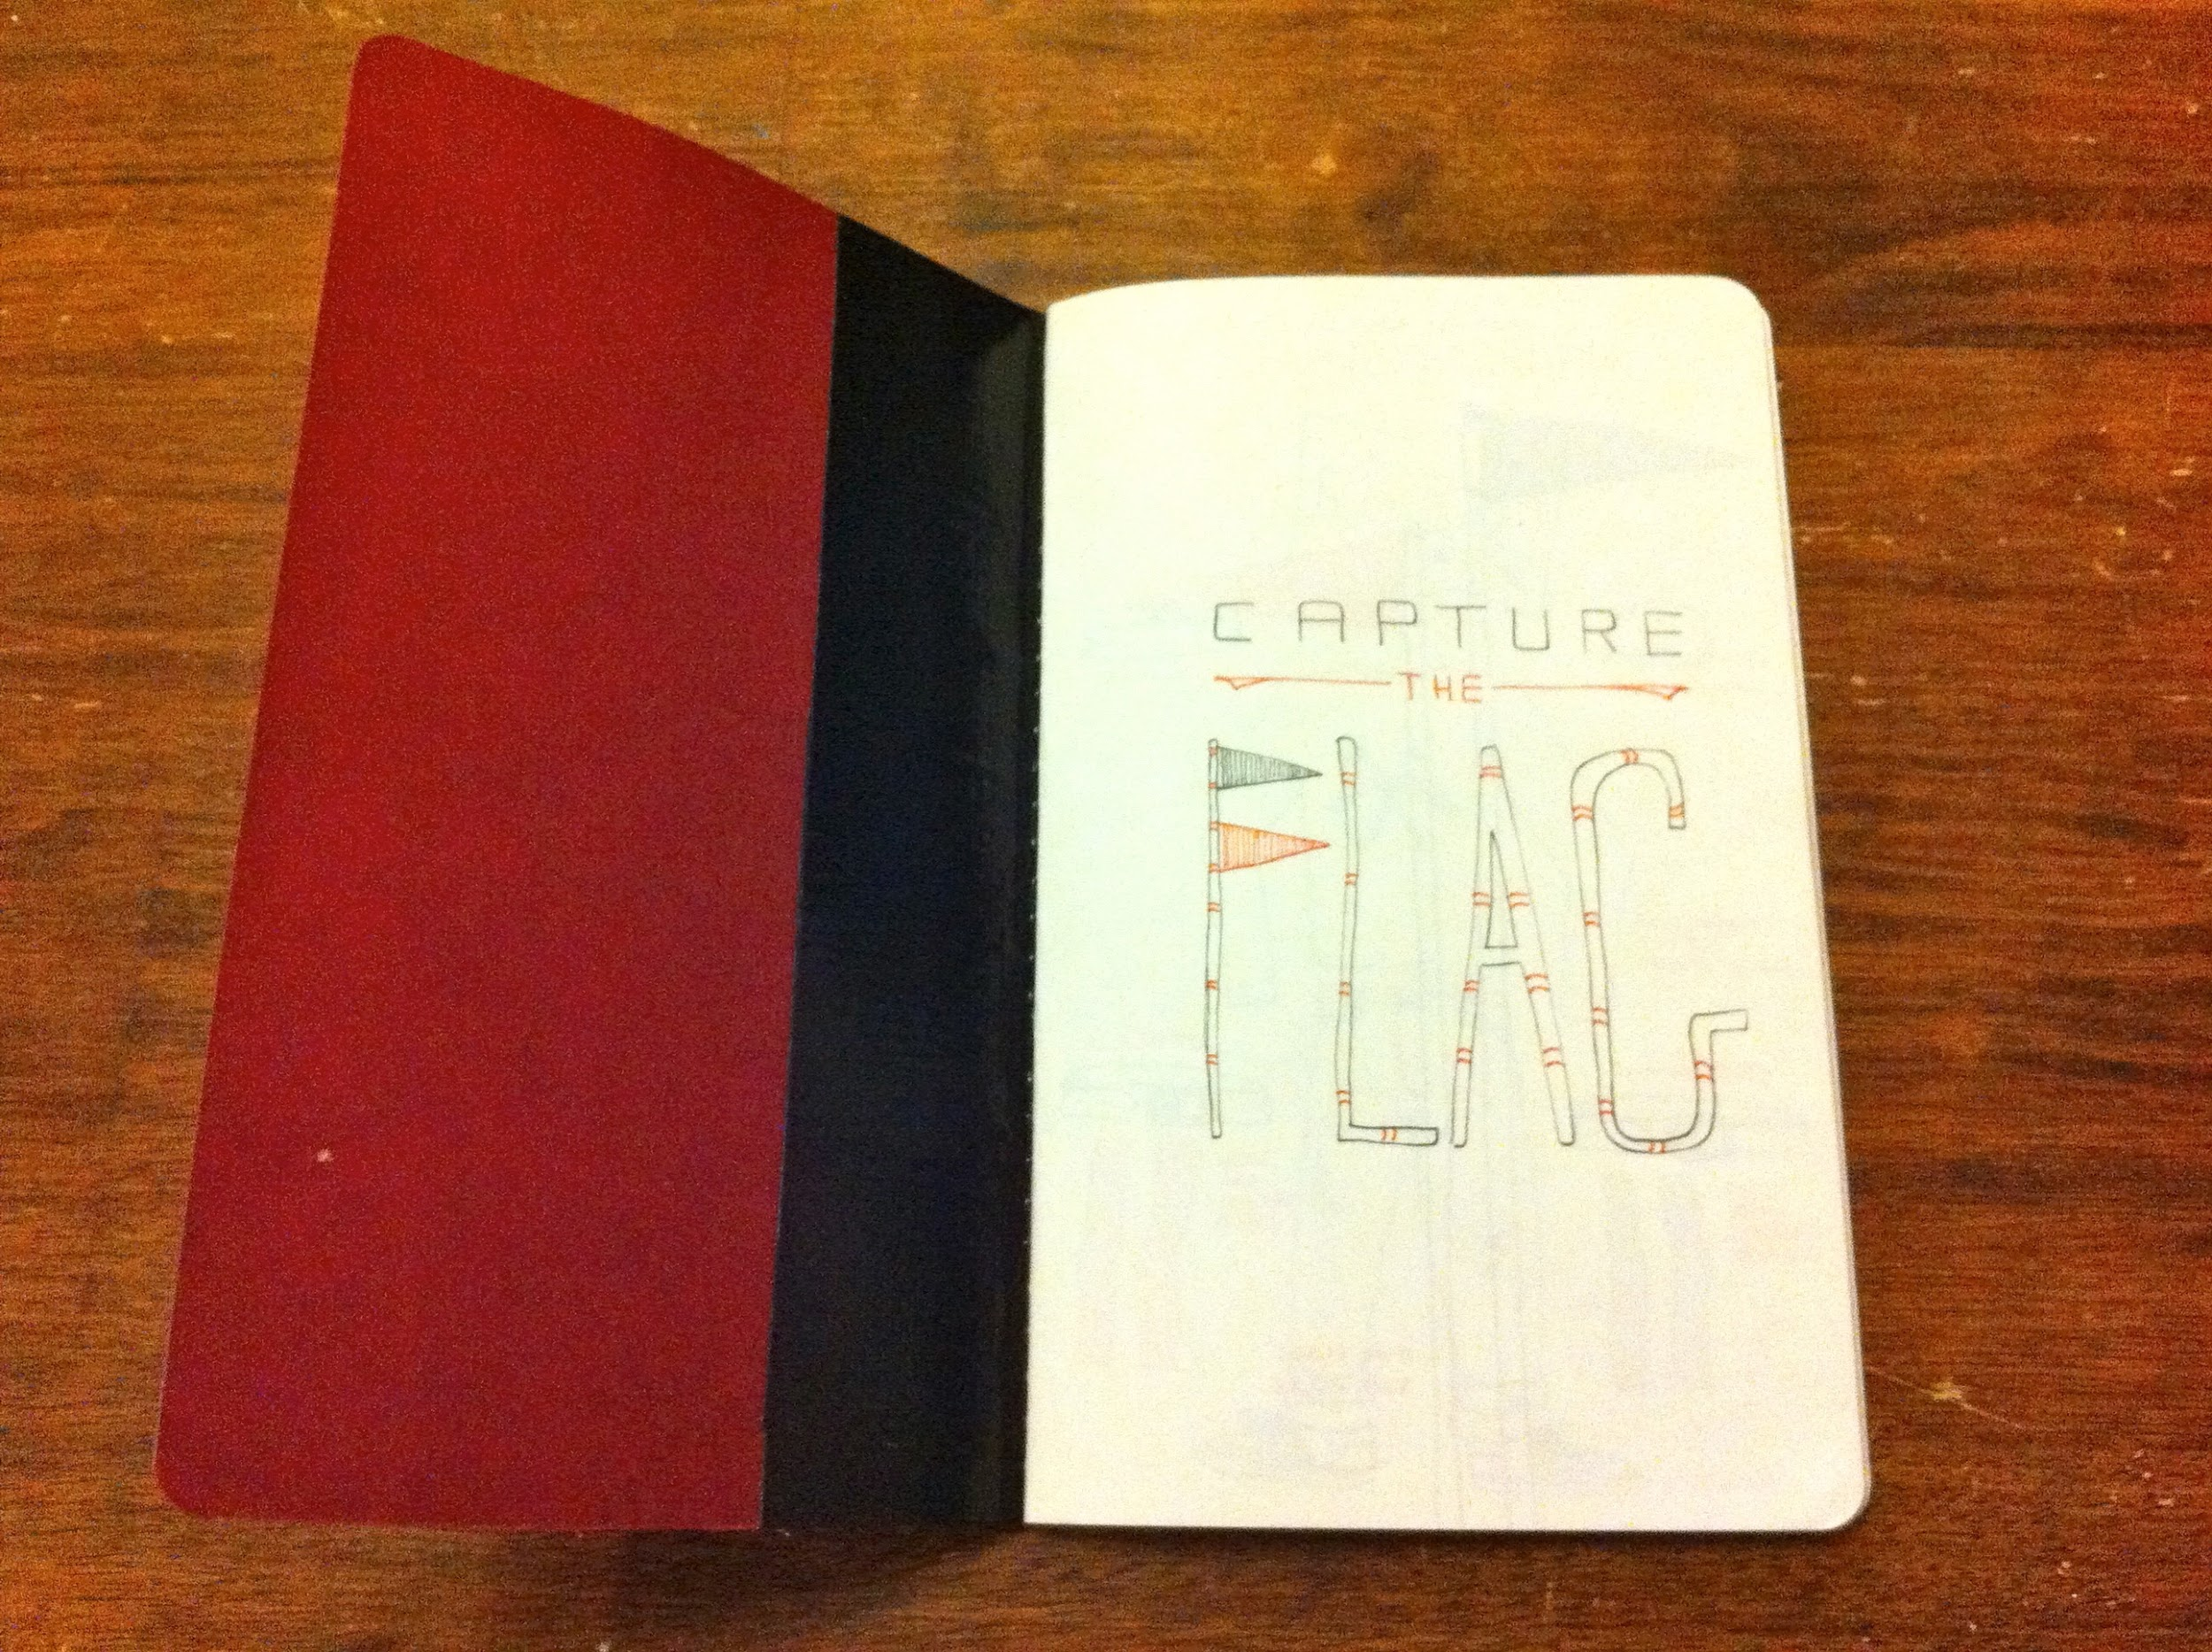
https://www.flickr.com/photos/14941806@N06/5723253006
Notes:
CTF competitions have been a staple at security events for years.
fun and competitive ways of showing off your skills and even learning about vulnerabilities and techniques you may not have known about.
Discuss how security finds value in CTF, how gamification is useful to attract and retain attention, how we struggle to get AppSec concepts to be retained

Slide 5
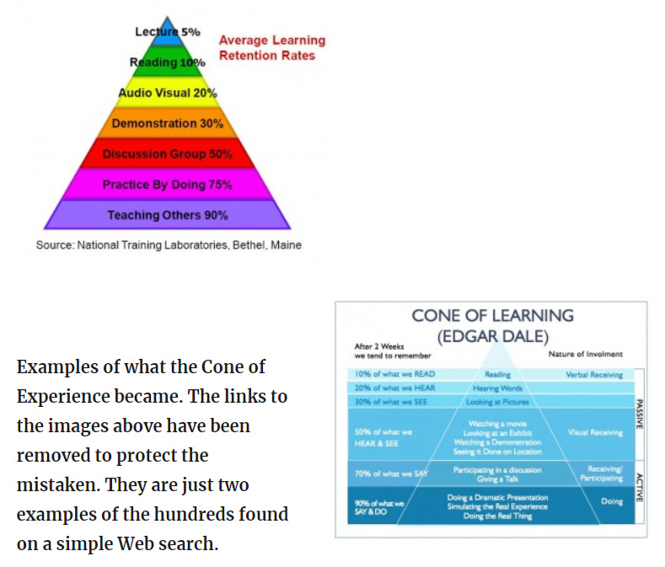

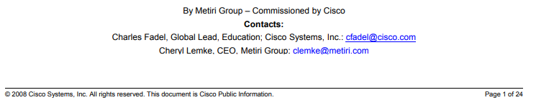
https://acrlog.org/2014/01/13/tales-of-the-undead-learning-theories-the-learning-pyramid
Notes:
Discuss theories of learning,
discuss discredited learning pyramid (how the original intent did not have percentages associated to it, how the numbers are suspiciously round, if reading is only 10% how are we expected to retain the learning pyramid if we are just reading about it).
Discuss Cisco commissioned study on multimodal learning

Slide 6
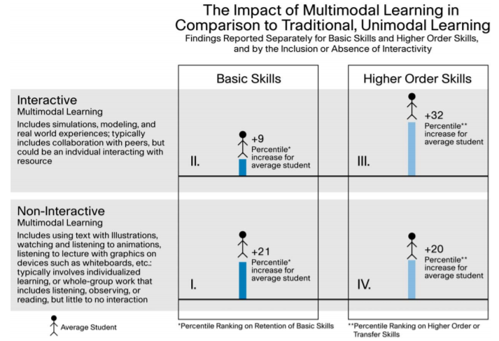
Multimodal Learning Through Media: What the Research Says
1. Multimedia Principle: Retention is improved through words and pictures rather than through words alone.
2. Spatial Contiguity Principle: Students learn better when corresponding words and pictures are presented near each other rather than far from each other on the page or screen.
3. Temporal Contiguity Principle: Students learn better when corresponding words and pictures are presented simultaneously rather than successively.
4. Coherence Principle: Students learn better when extraneous words, pictures, and sounds are excluded rather than included.
5. Modality Principle: Students learn better from animation and narration than from animation and on-screen text.
6. Redundancy Principle: Students learn better when information is not represented in more than one modality – redundancy interferes with learning.
7a. Individual Differences Principle: Design effects are higher for low-knowledge learners than for high-knowledge learners.
7b. Individual Differences Principle: Design effects are higher for high-spatial learners rather than for low-spatial learners.
8. Direct Manipulation Principle: As the complexity of the materials increase, the impact of direct manipulation of the learning materials (animation, pacing) on transfer also increases
https://www.cisco.com/c/dam/en_us/solutions/industries/docs/education/Multimodal-Learning-Through-Media.pdf
Notes:
Since i have played CTFs decided to build on a CTF as a learning tool
not just because it would be fun, but because there is solid research showing that attention and retention increase with multimodal learning.
Brief coverage of 2 separate audiences (internal engineers & customer developers)
most significant increase is when the learner is an active participant in the training.
Discuss Salesforce shared security concepts, security training targeted at admins and developers and how we wanted to increase interaction and therefore retention.
Using Juice Shop for internal and deliberately insecure Org as a basis for challenges.
Direct manipulation of a real world experience, i.e. performing all of the steps required to turn an insecure Salesforce challenge org into a more secure one, ensures that the participants will be learning in a way with the the highest measured success rate.
Talk about quadrant 3 and the Direct Manipulation Principle.

Slide 7
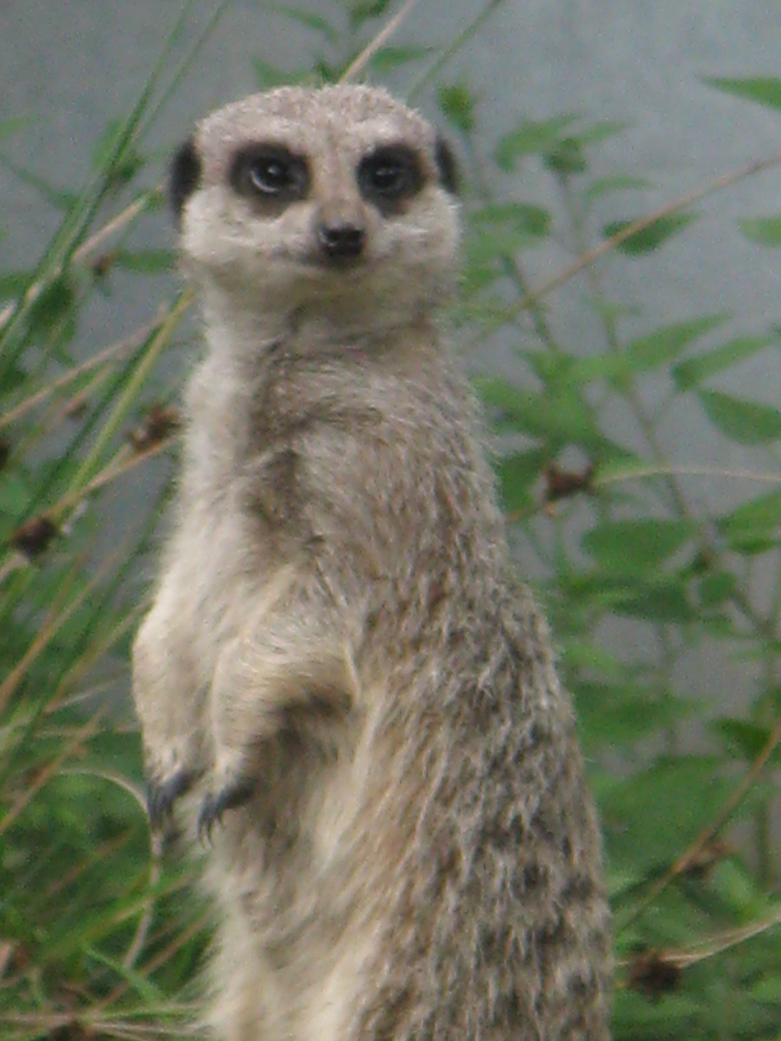
https://www.flickr.com/photos/12495774@N02/3899511543
Notes:
Discuss audience types, previous security interaction, etc.
Discuss how CTF is being developed for internal engineer training, cite approximate ratio of security to engineers at Salesforce. Describe onboarding bootcamp and the role of Security Essentials as part of that (was 1 day of semi-hands on training, now moving to integrate CTF throughout the entire week)
Discuss a bit about TDX & DF audiences & successes

Slide 8
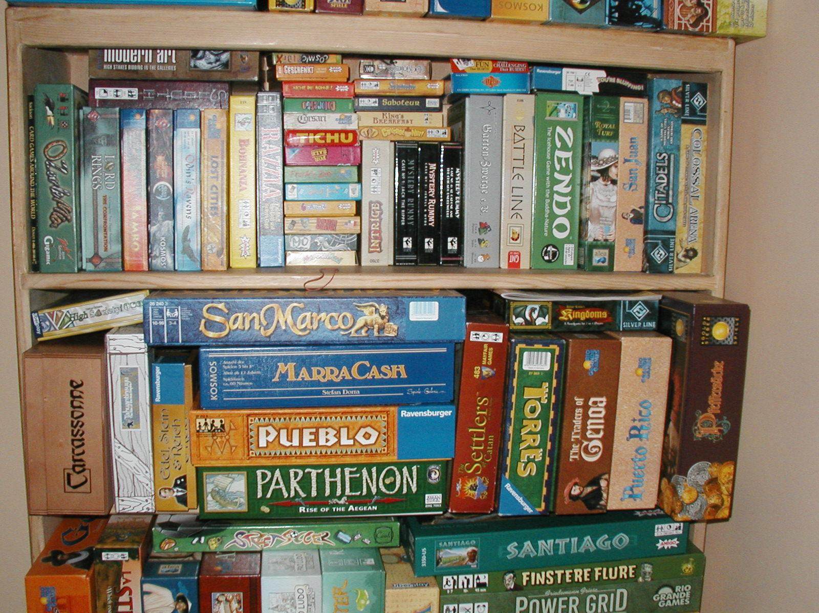
https://www.flickr.com/photos/41894172356@N01/73752367
Notes:
goal is using the gamification aspect CTFs to increase knowledge, then interaction is key.
needed to have something approachable and easy to use.
are competing for limited time and attention, so it is not enough just to draw them in with an initial pitch, we need the entire experience to be smooth and engaging the whole time they are playing the CTF.
Having an integrated and straightforward experience to evaluate the participants success and track their progress was essential to maintain interaction and maximize learning.

Slide 9
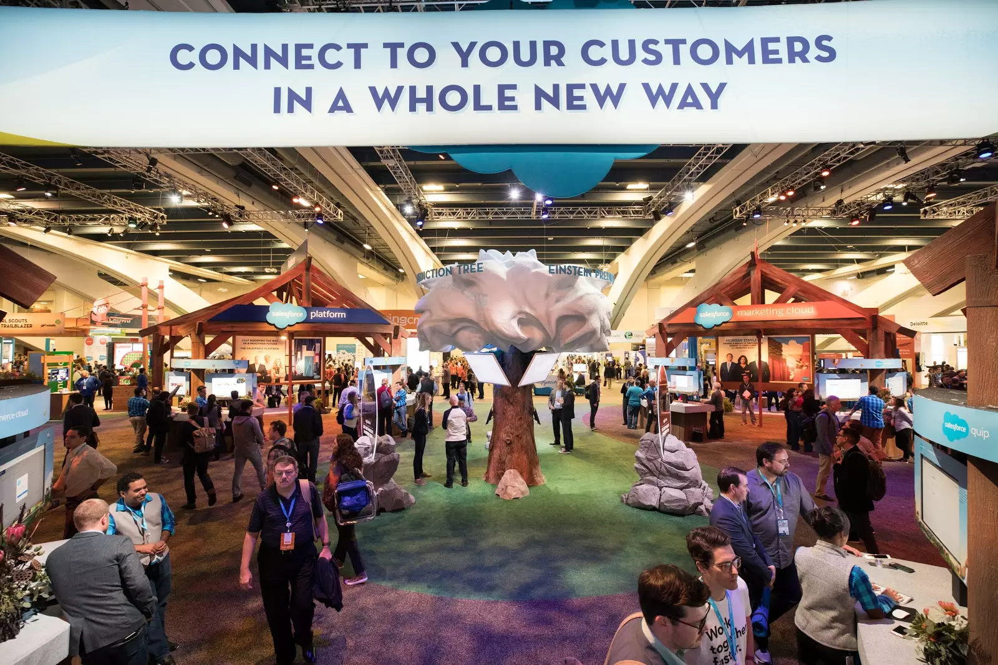
https://trailhead.salesforce.com/pt-BR/content/learn/modules/get_ready_for_dreamforce_onsite/get_ready_for_dreamforce_onsite_get_to_know_the_campus
Notes:
When you are trying to perform security education in this environment you need something compelling

Slide 10
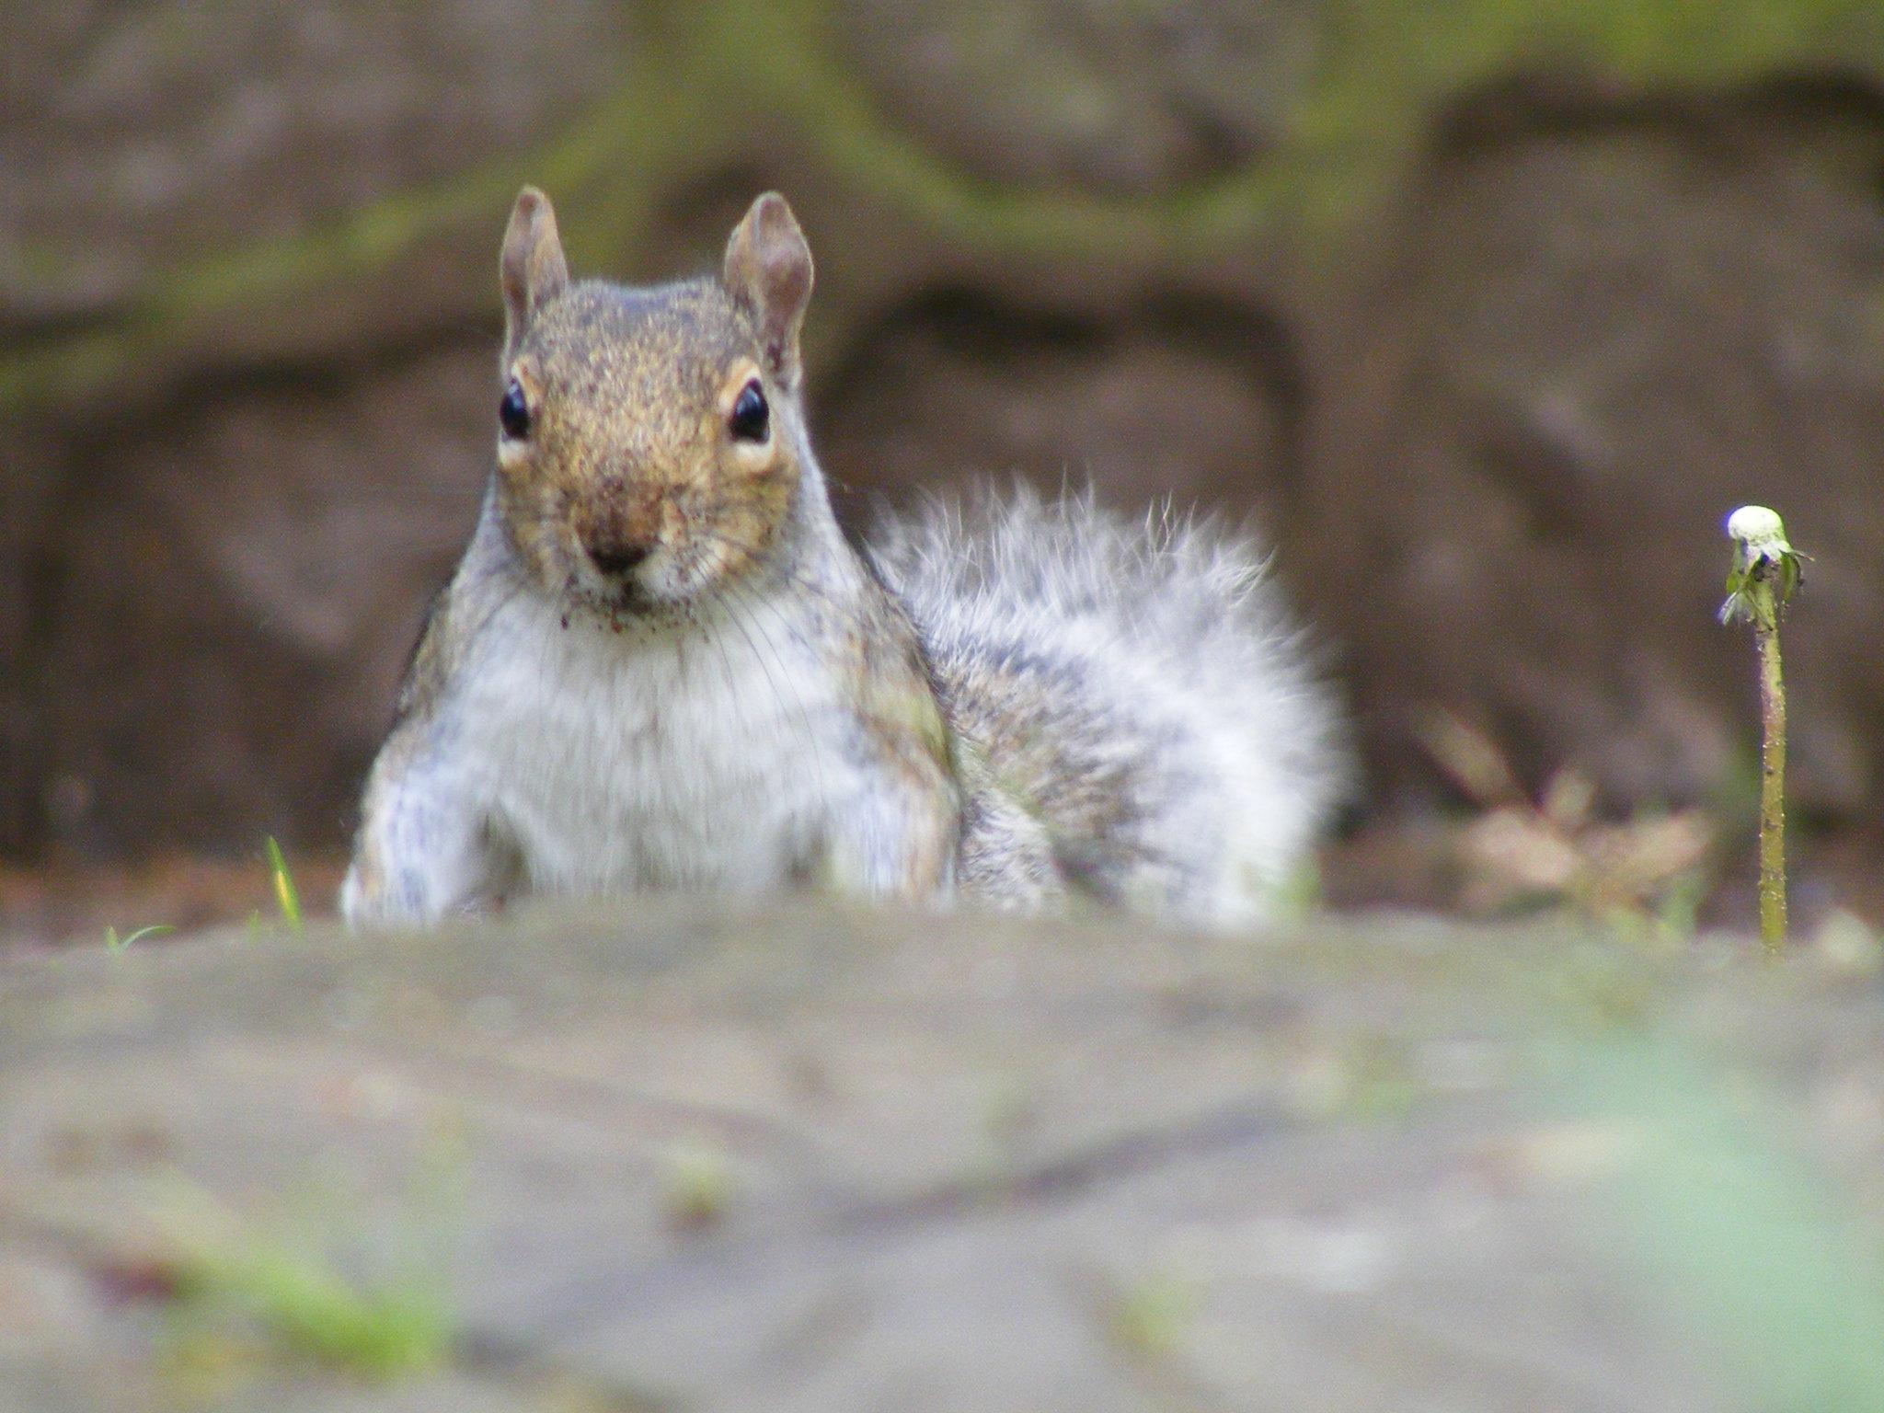
1. Multimedia Principle: Retention is improved through words and pictures rather than through words alone.
2. Spatial Contiguity Principle: Students learn better when corresponding words and pictures are presented near each other rather than far from each other on the page or screen.
3. Temporal Contiguity Principle: Students learn better when corresponding words and pictures are presented simultaneously rather than successively.
4. Coherence Principle: Students learn better when extraneous words, pictures, and sounds are excluded rather than included.
5. Modality Principle: Students learn better from animation and narration than from animation and on-screen text.
6. Redundancy Principle: Students learn better when information is not represented in more than one modality – redundancy interferes with learning.
7a. Individual Differences Principle: Design effects are higher for low-knowledge learners than for high-knowledge learners.
7b. Individual Differences Principle: Design effects are higher for high-spatial learners rather than for low-spatial learners.
8. Direct Manipulation Principle: As the complexity of the materials increase, the impact of direct manipulation of the learning materials (animation, pacing) on transfer also increases
https://www.flickr.com/photos/37984062@N03/3495248498
Notes:
improved our focus to ensure that participants have minimal friction when interacting with Salesforce and the CTF scoring system.
Keep players in the moment by keeping the description of what they need to accomplish directly inline with the functionality to evaluate their challenge and issue their flags.
Minimized redundancy and maximized the spatial and temporal contiguity in order to give the players an environment that supports learning and retention.

Slide 11
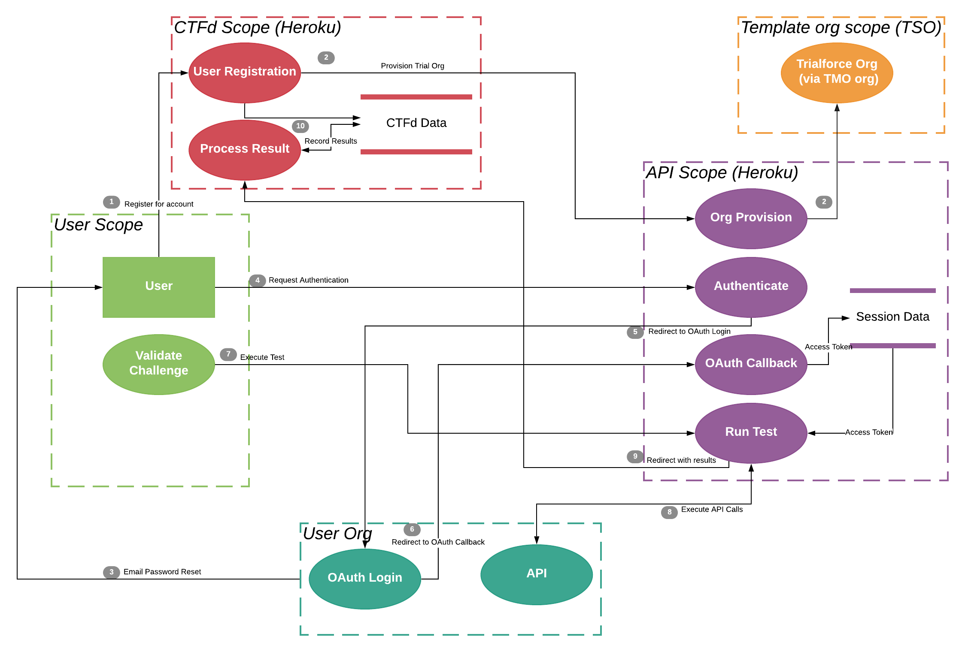
https://engineering.salesforce.com/capture-the-flag-secure-your-knowledge-37b43180e55a
Notes:
Architecture diagram, demonstrate availability points, extensibility to work with other products and automation to make on demand deployment straightforward

Slide 12
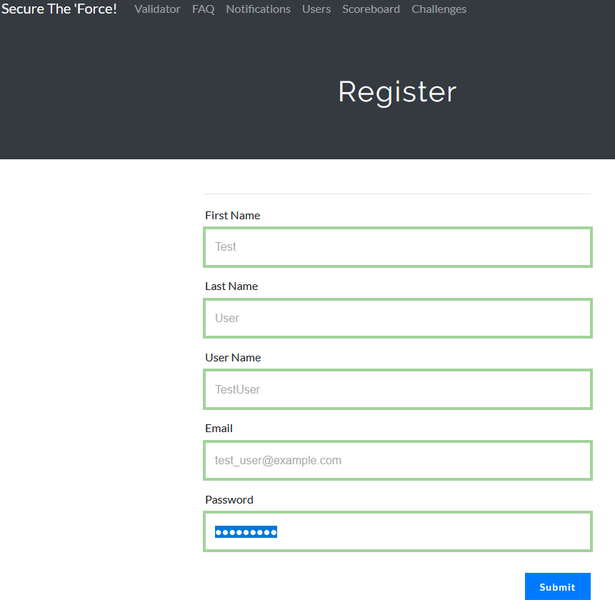
Notes:
Demo of integration

Slide 13
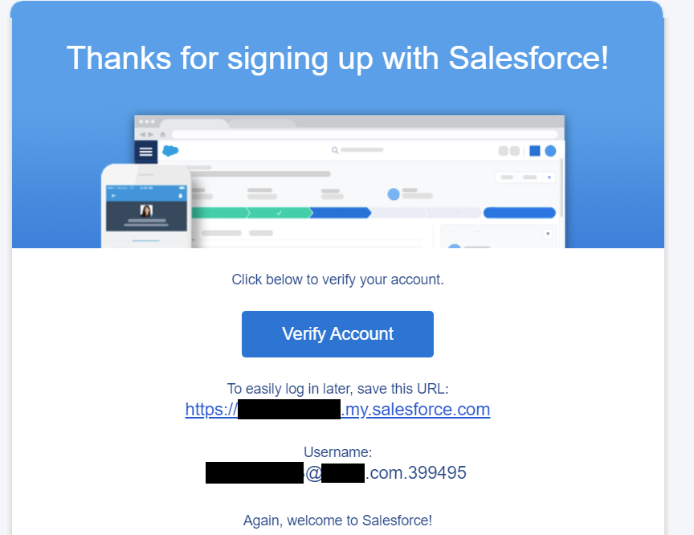
Notes:
Demo of integration

Slide 14
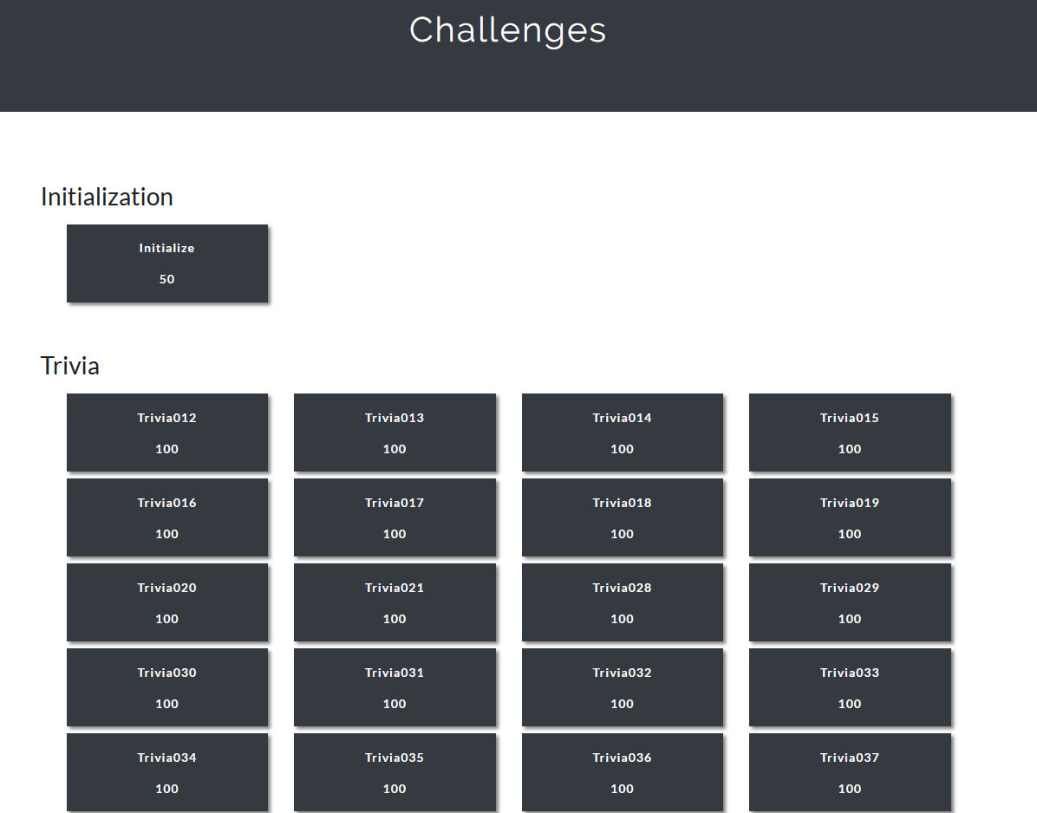
Notes:
Demo of integration

Slide 15
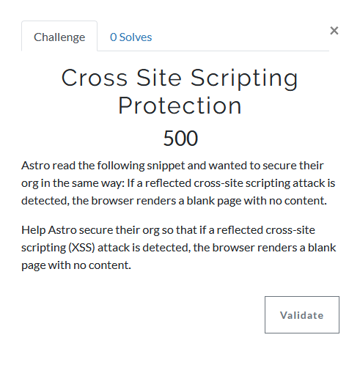
Notes:
Demo of integration

Slide 16
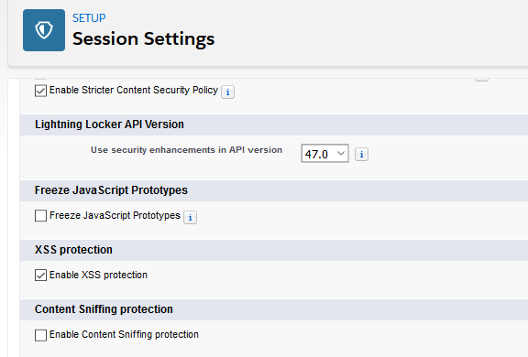
Notes:
Demo of integration

Slide 17
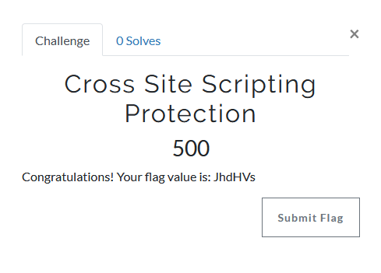
Notes:
Demo of integration

Slide 18
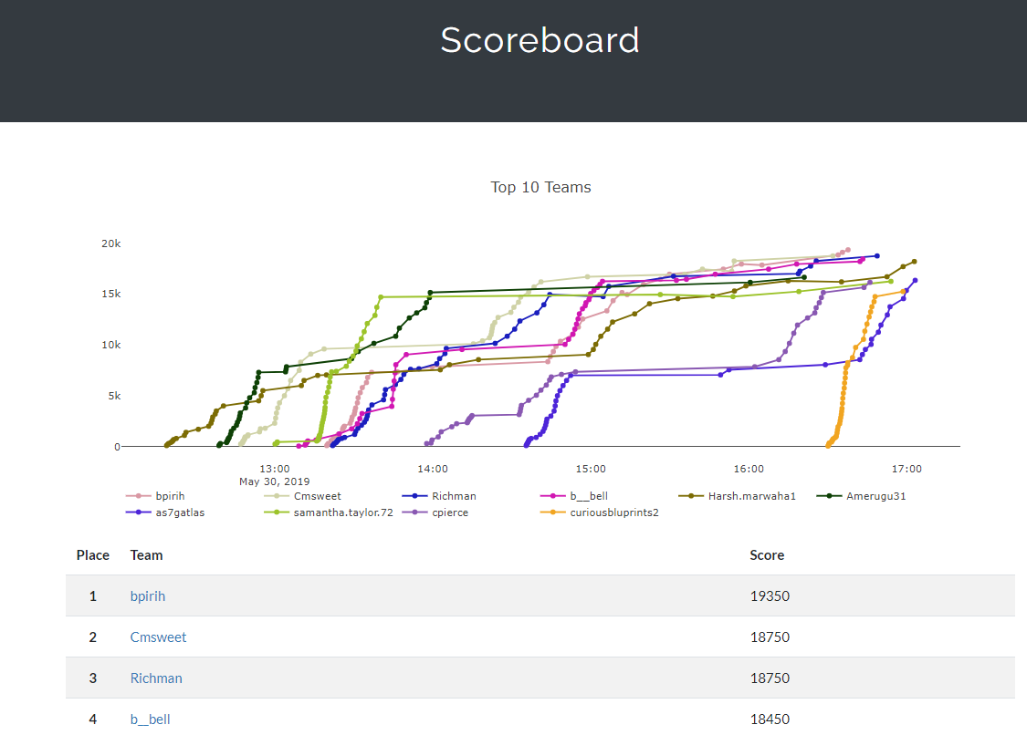
Notes:
Demo of integration

Slide 19
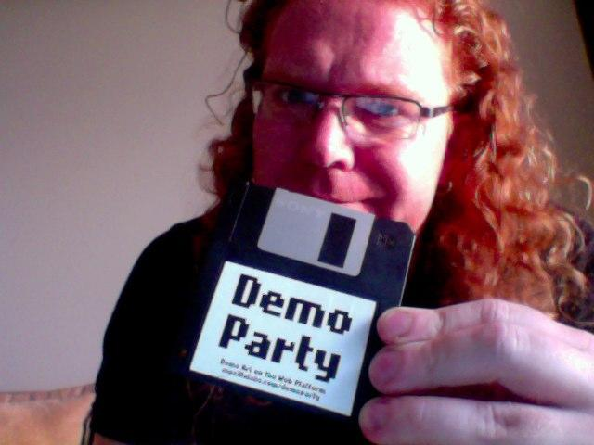
https://flickr.com/photos/codepo8/5790470307/
Notes:
Hands on demonstration of integrated challenge solution

Slide 20
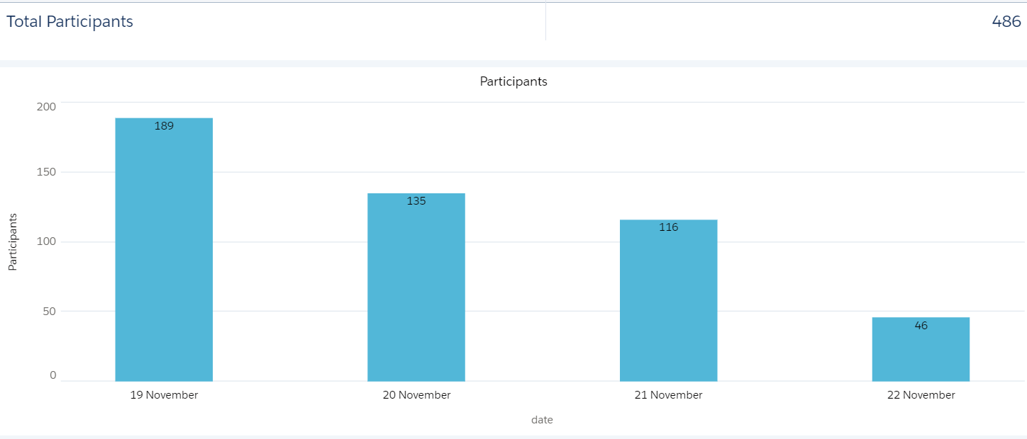
https://engineering.salesforce.com/play-games-learn-better-fc782757c884
Notes:
Metrics on number of participants

Slide 21
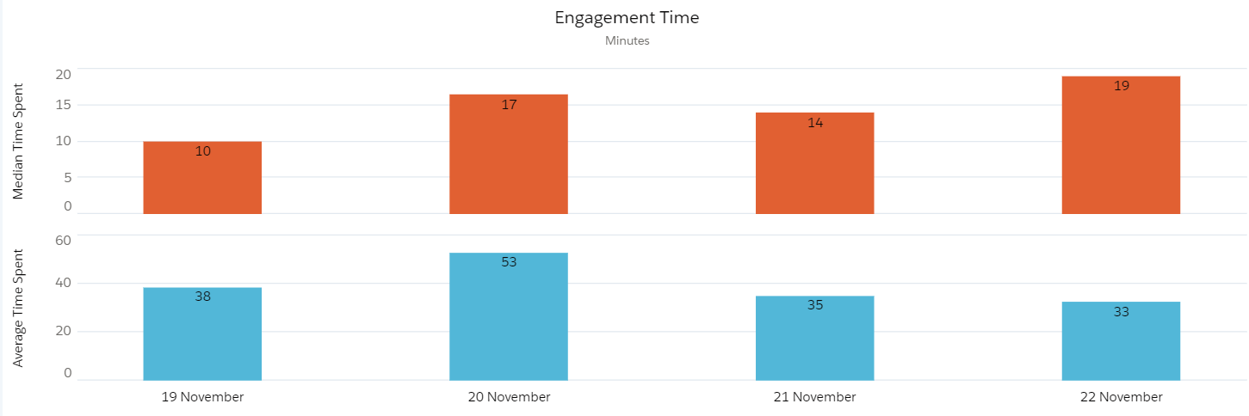
https://engineering.salesforce.com/play-games-learn-better-fc782757c884
Notes:
Metrics on number of participants and number of correct answers in Secure the 'Force for DF19

Slide 22
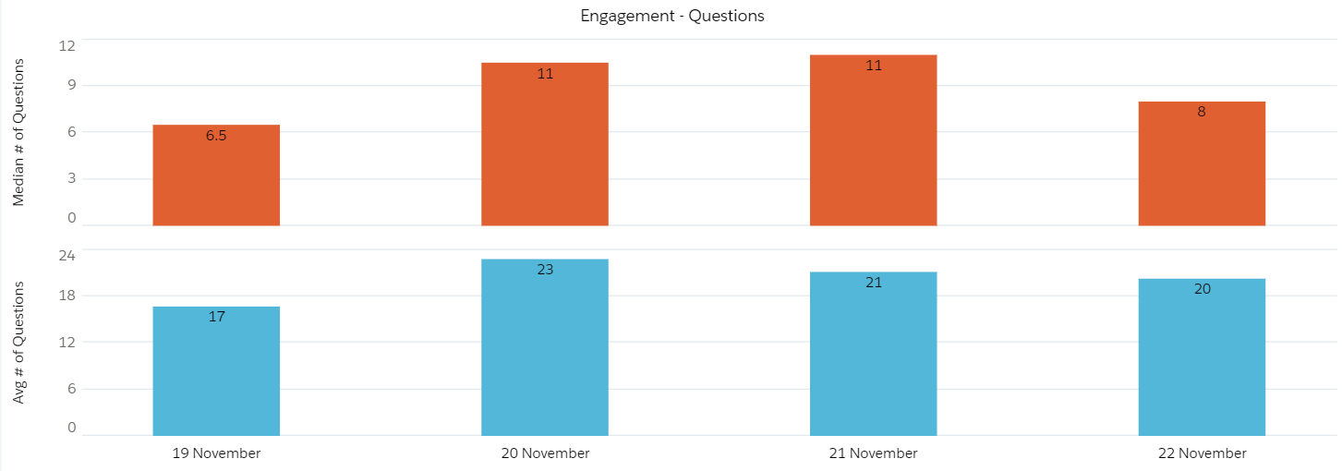
https://engineering.salesforce.com/play-games-learn-better-fc782757c884
Notes:
Metrics on interaction of participants

Slide 23
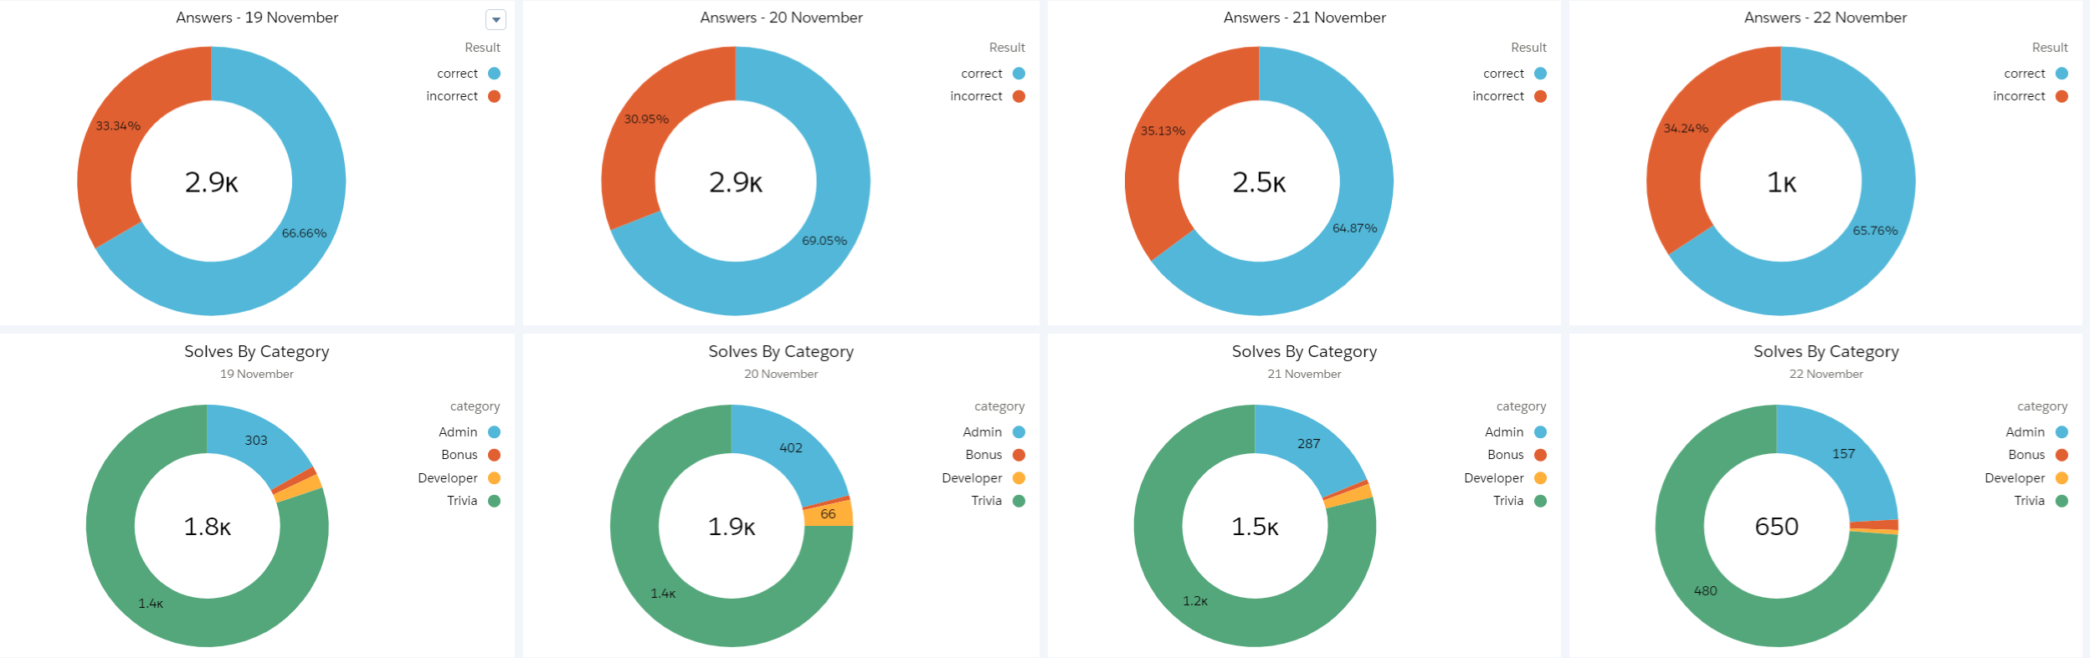
https://engineering.salesforce.com/play-games-learn-better-fc782757c884
Notes:
Now that we have covered the Why we will go through the What.

Slide 24
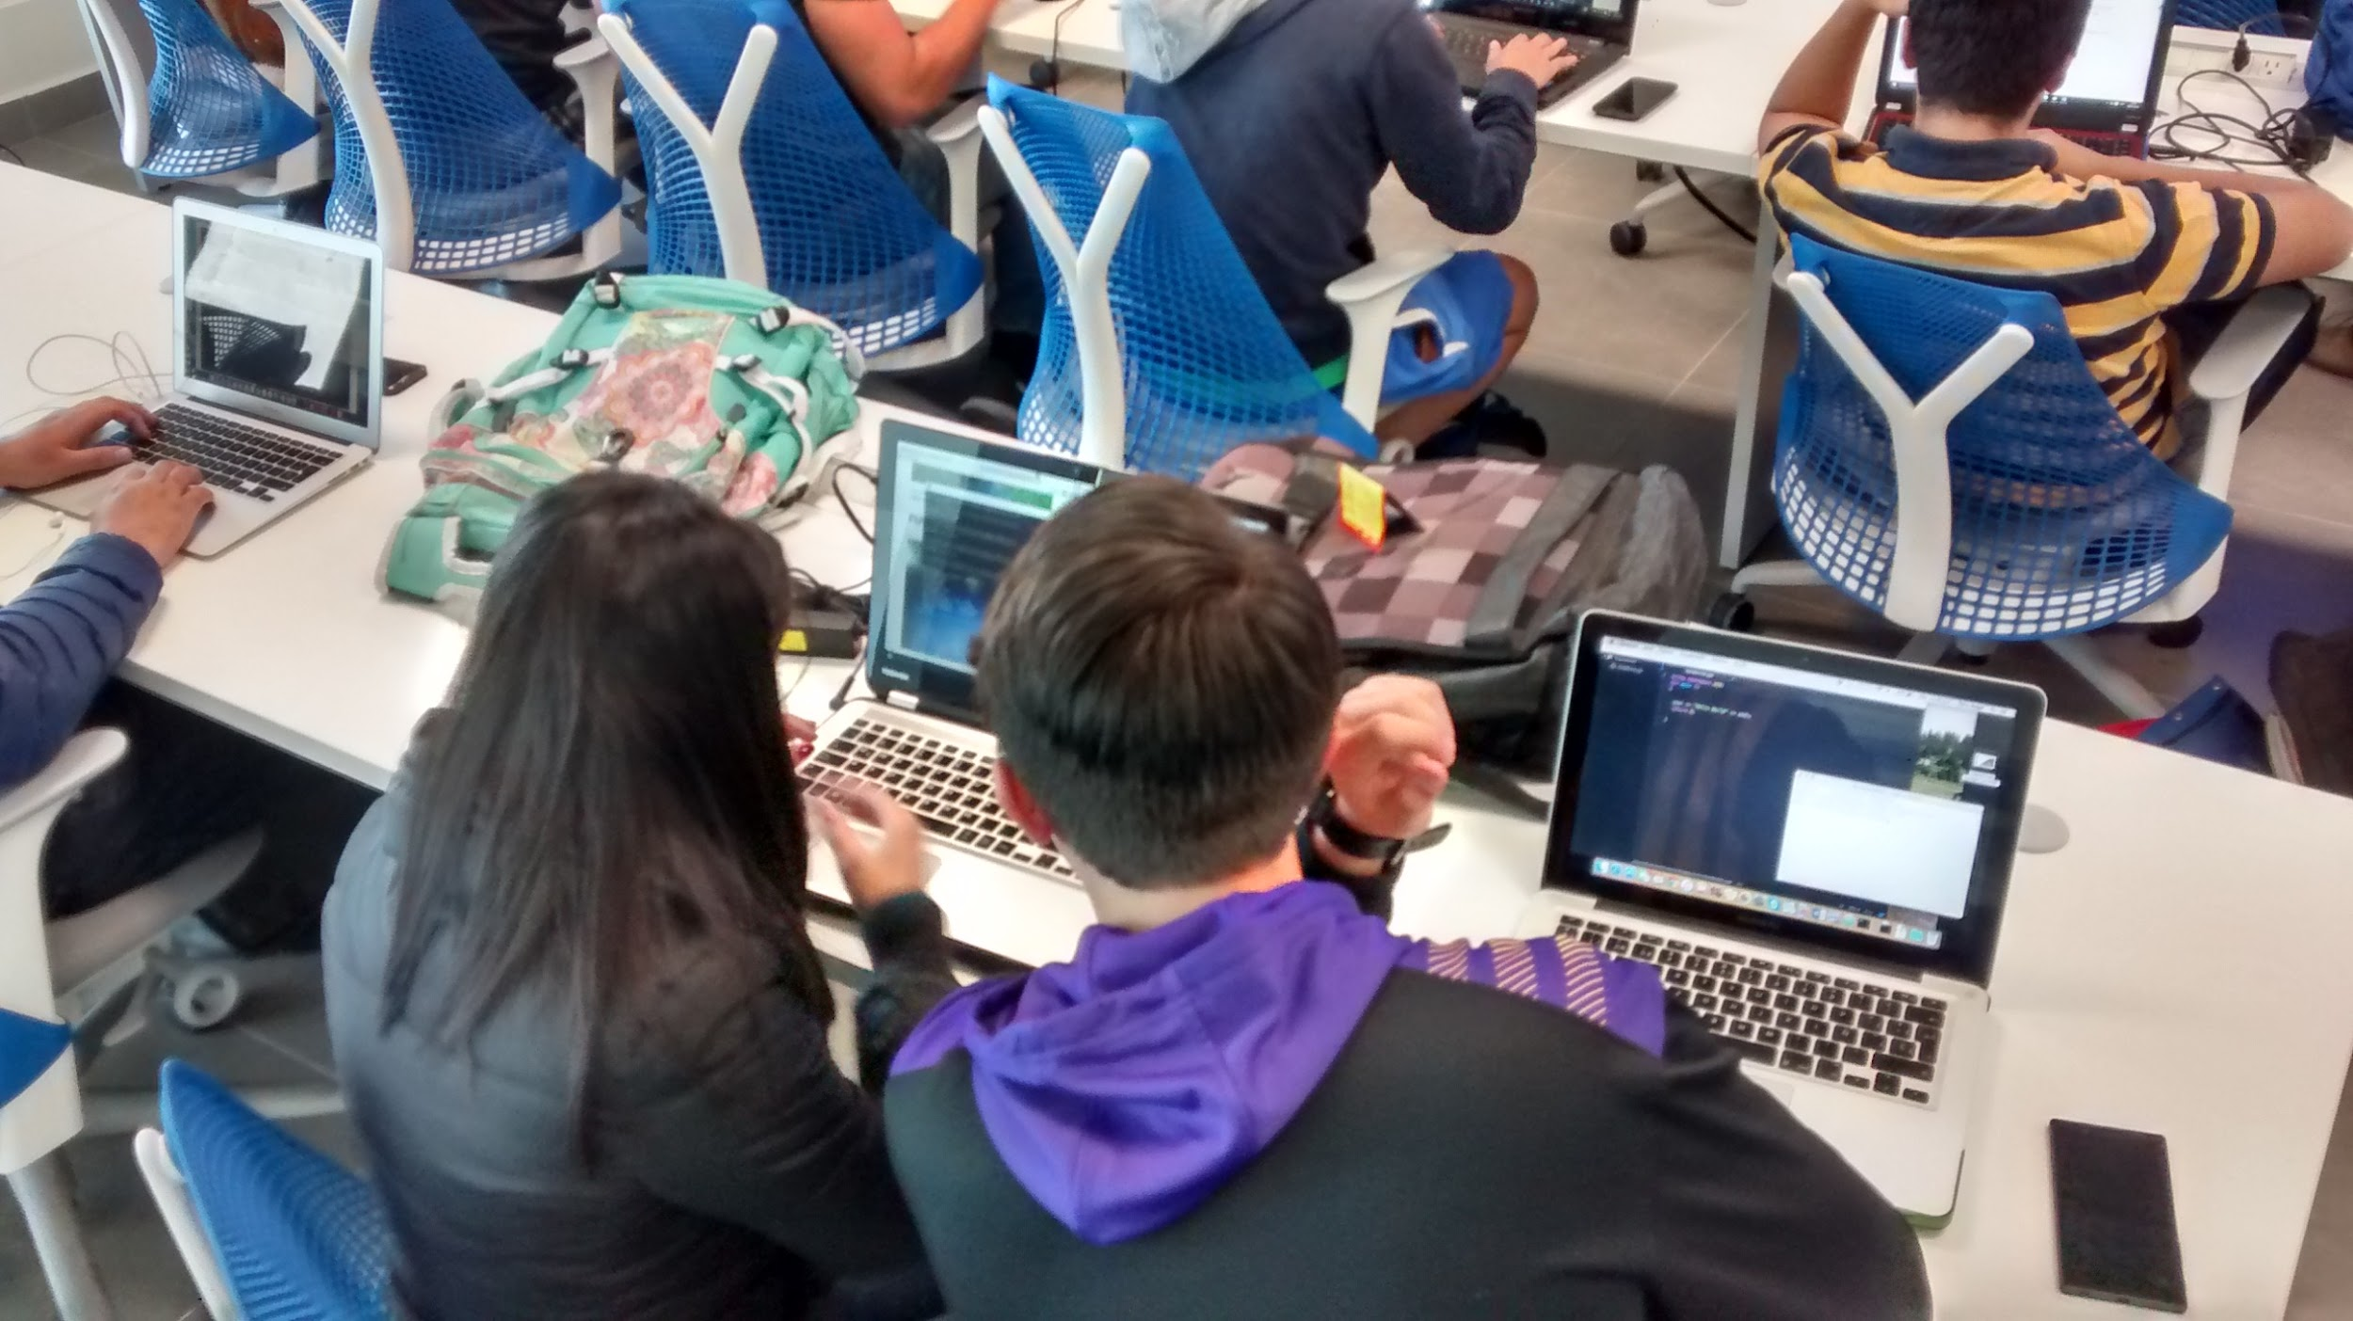
https://www.flickr.com/photos/35509232@N06/24271690249
Notes:
Audience Considerations
Developers/QA
Admins/Business
Teens
Mixed audiences

Slide 25
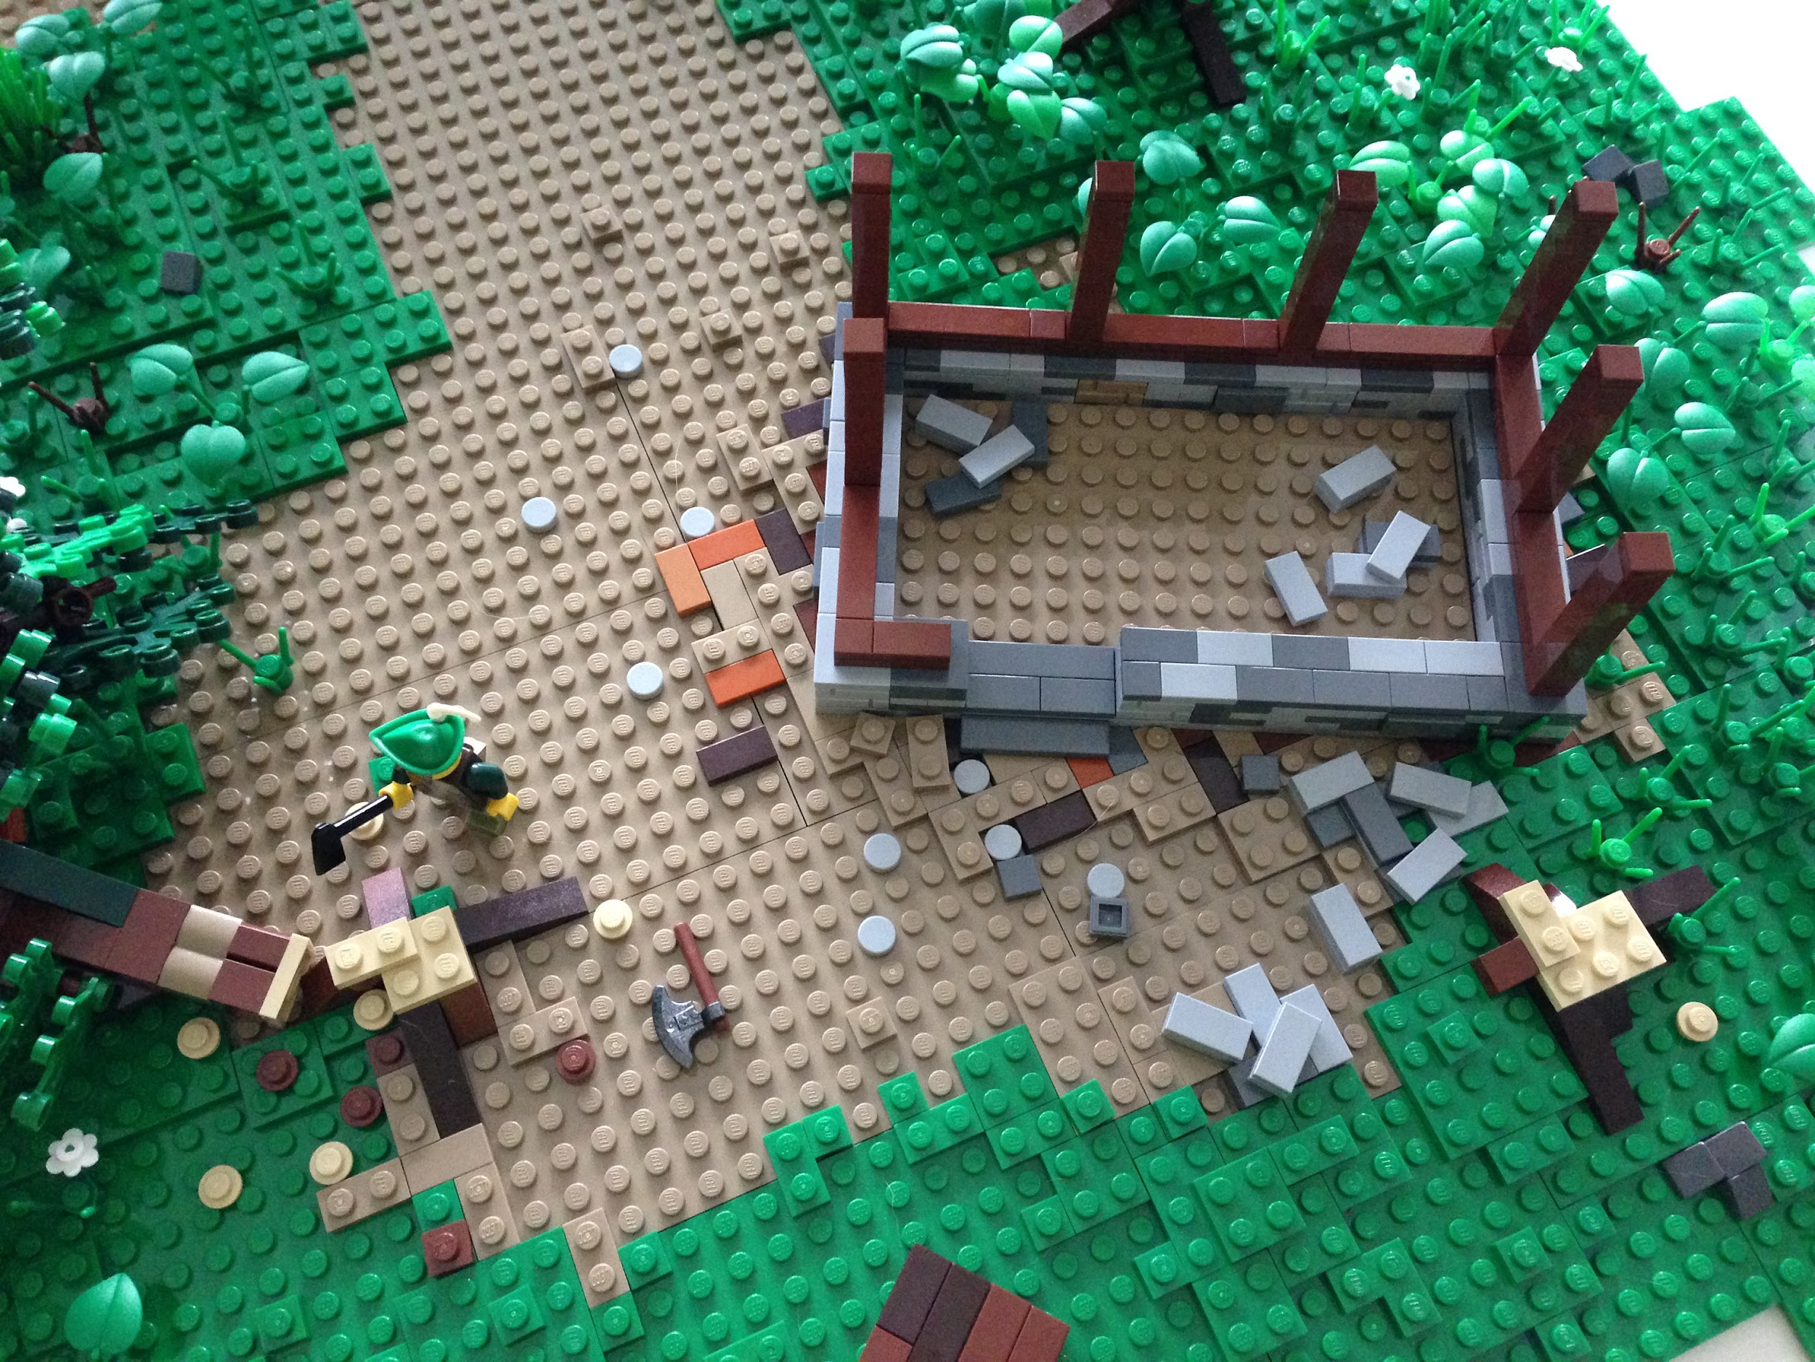
https://www.flickr.com/photos/79673928@N08/10519784515
Notes:
First step: Building challenges section

Slide 26
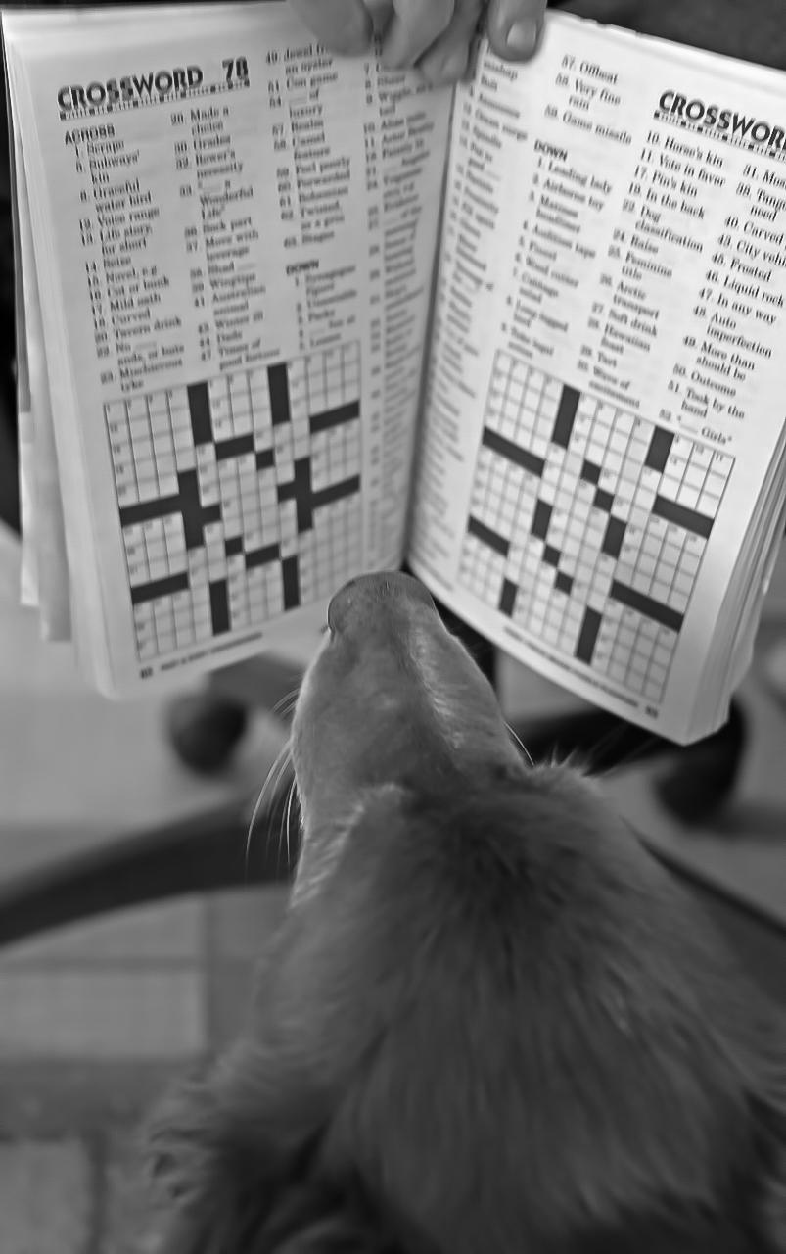
https://www.flickr.com/photos/78814955@N00/46868044302
Notes:
Building challenges - Key considerations to keep in mind: appropriateness, difficulty, playability

Slide 27
Relevancy - challenges should use the same technologies and platforms that the participants work in
Appropriateness - challenges should cover vulnerability categories that are known to exist in the participants codebases
Interesting/Engaging - challenges should draw the participants attention and encourage them to find solutions
Solvable - challenges should have a clear and accurate solution
Reflective - challenges should reinforce targeted concepts
Notes:
Building challenges - Key considerations to keep in mind: appropriateness, difficulty, playability

Slide 28
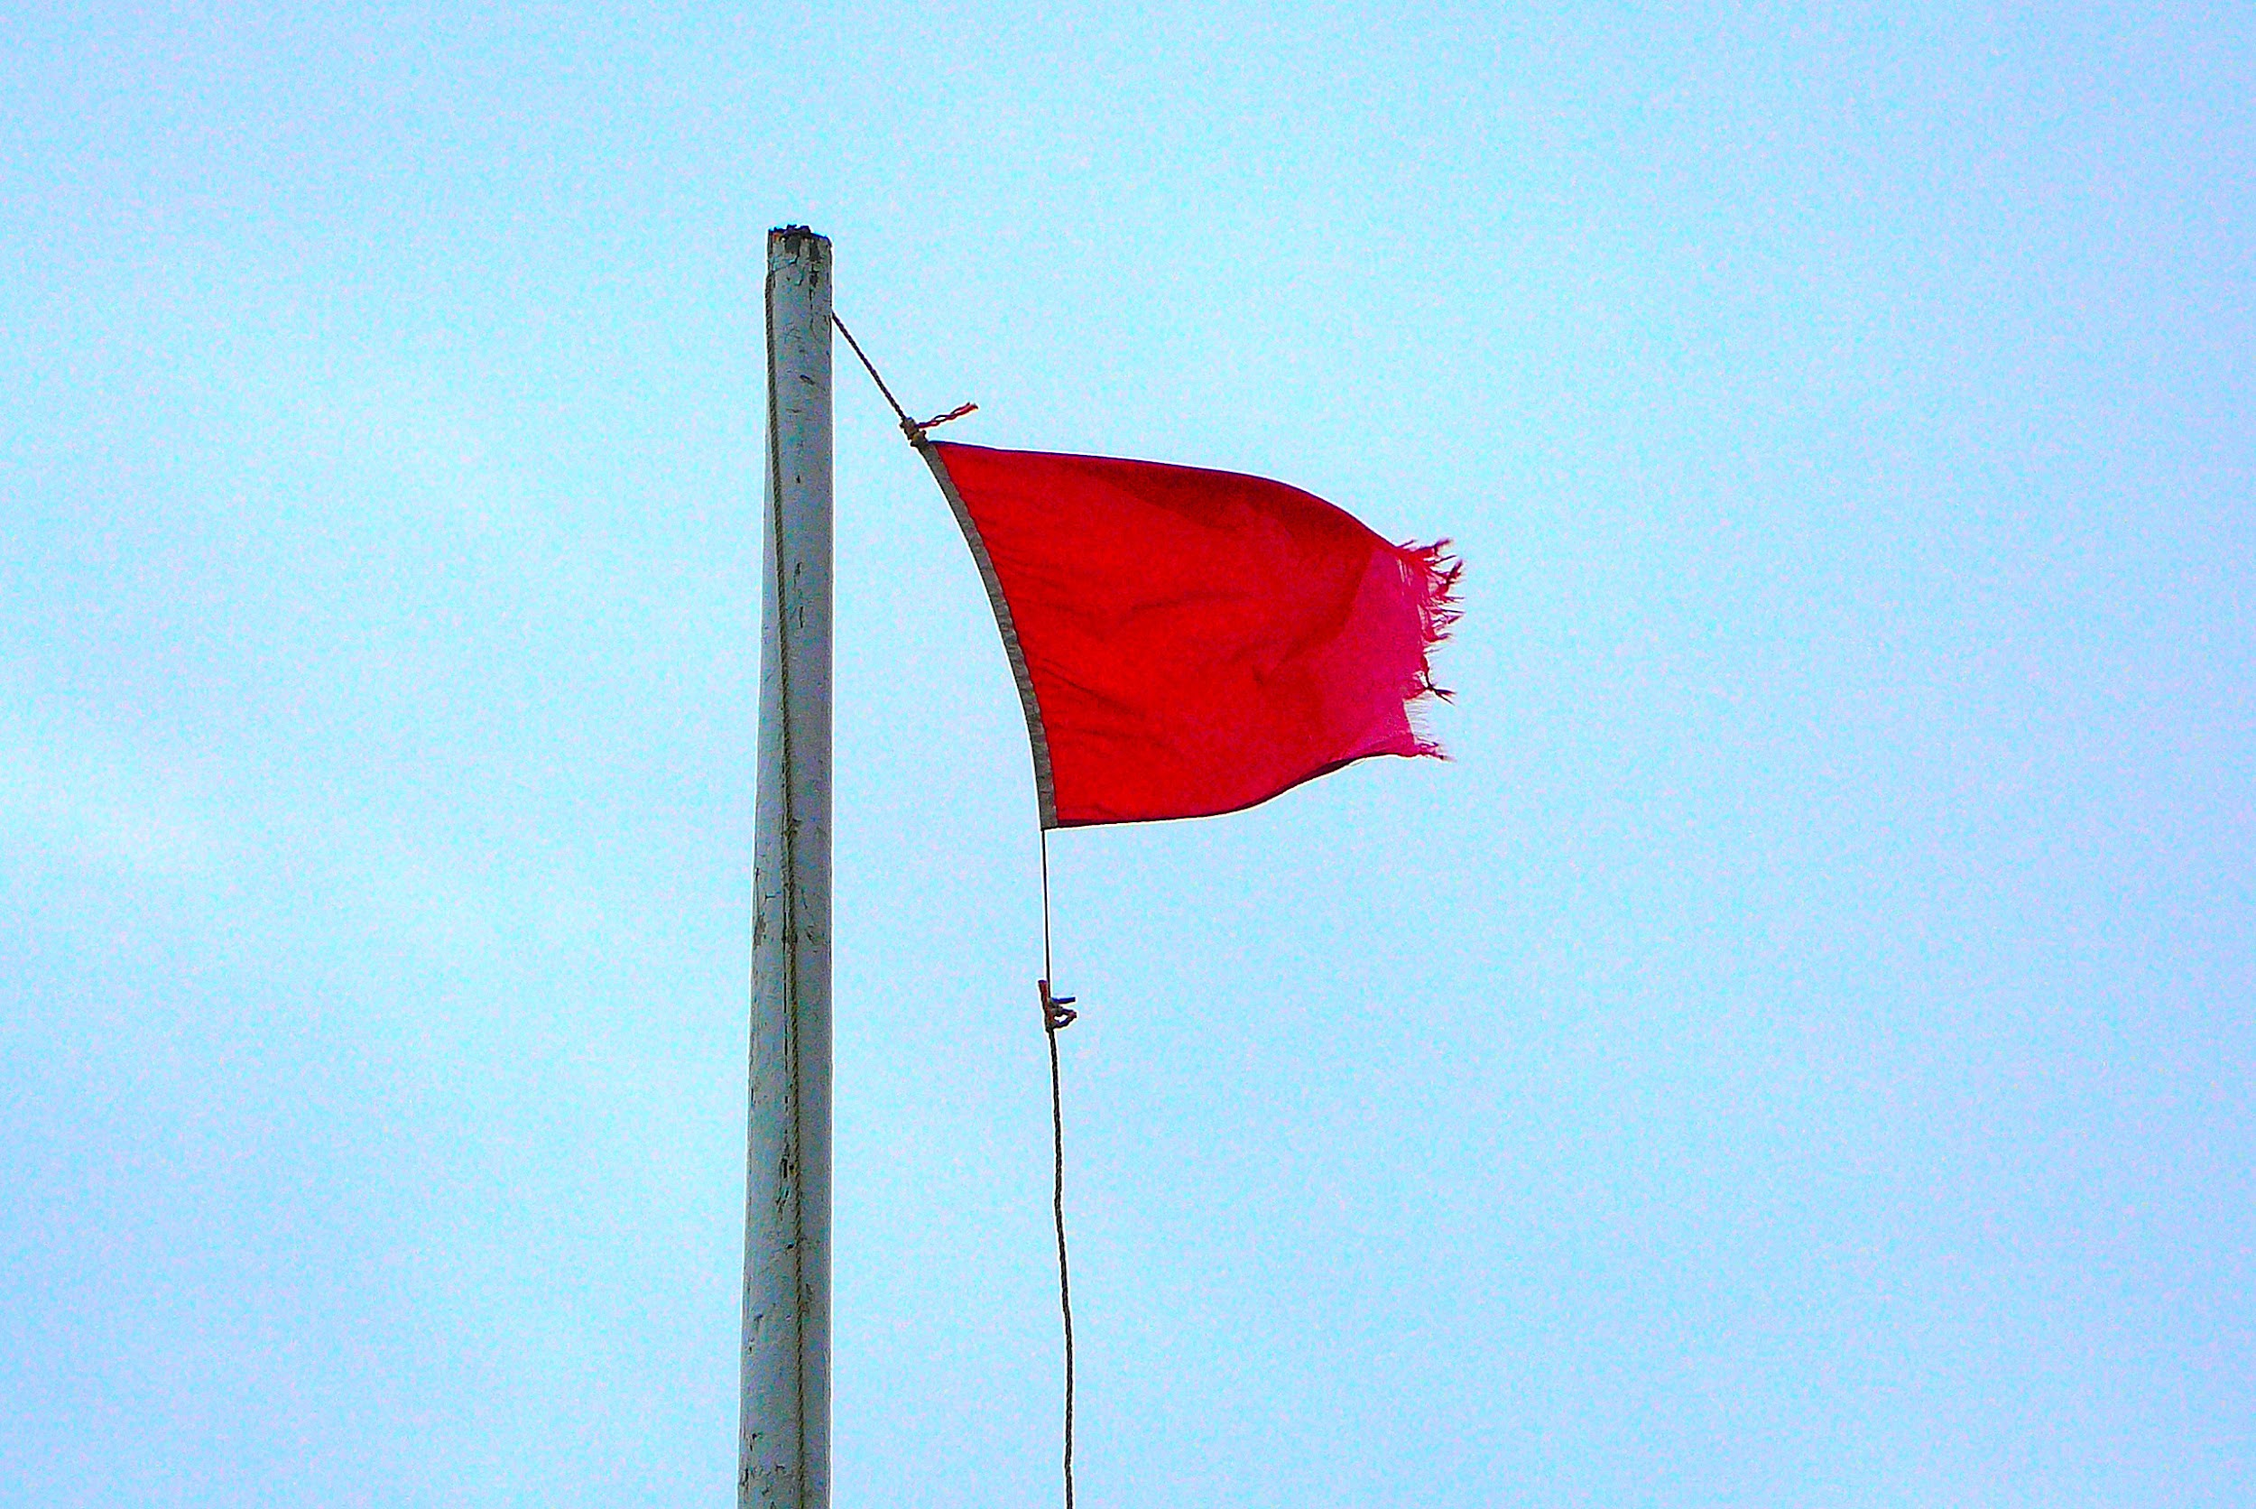
https://www.flickr.com/photos/93416311@N00/2195946360
Notes:
Building challenges - Red flags

Slide 29
Red Flags - Avoid
Excessive Obscurity - solutions should be discoverable (with a reasonable amount of effort)
Non-Relevant - work to solve challenges should not be far outside of the participants skill set and work requirements
Open Ended - challenges should have enough guidance to allow the participant to find an agreed upon “good” solution
Notes:
Building challenges - Red flags

Slide 30
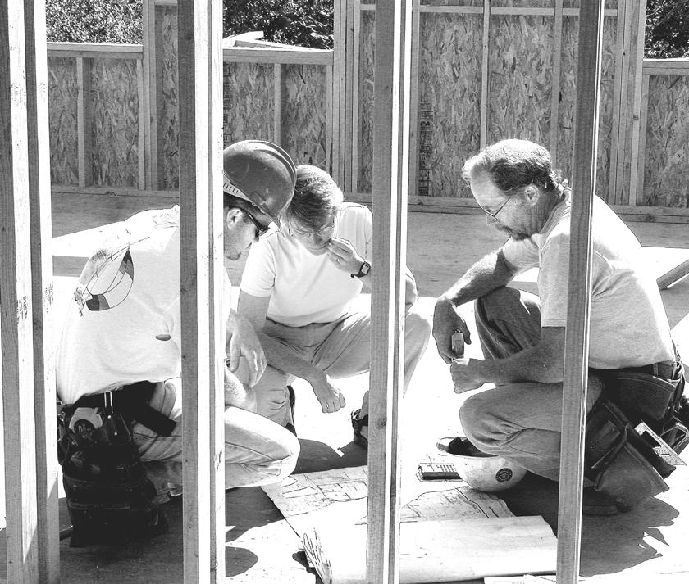
https://www.flickr.com/photos/21597369@N06/2091577071
Notes:
Building challenges: collaboration is a great way to build good challenges.
stay focused
limit the challenges to a small number of specific themes.
Think of the most prevalent security issues in your organization and target the challenges in that way.
Agile techniques are useful: collaboration, testing and reflection (retrospective) then iterating to hone the challenges.
Later in the How section we will review technology that can help.

Slide 31
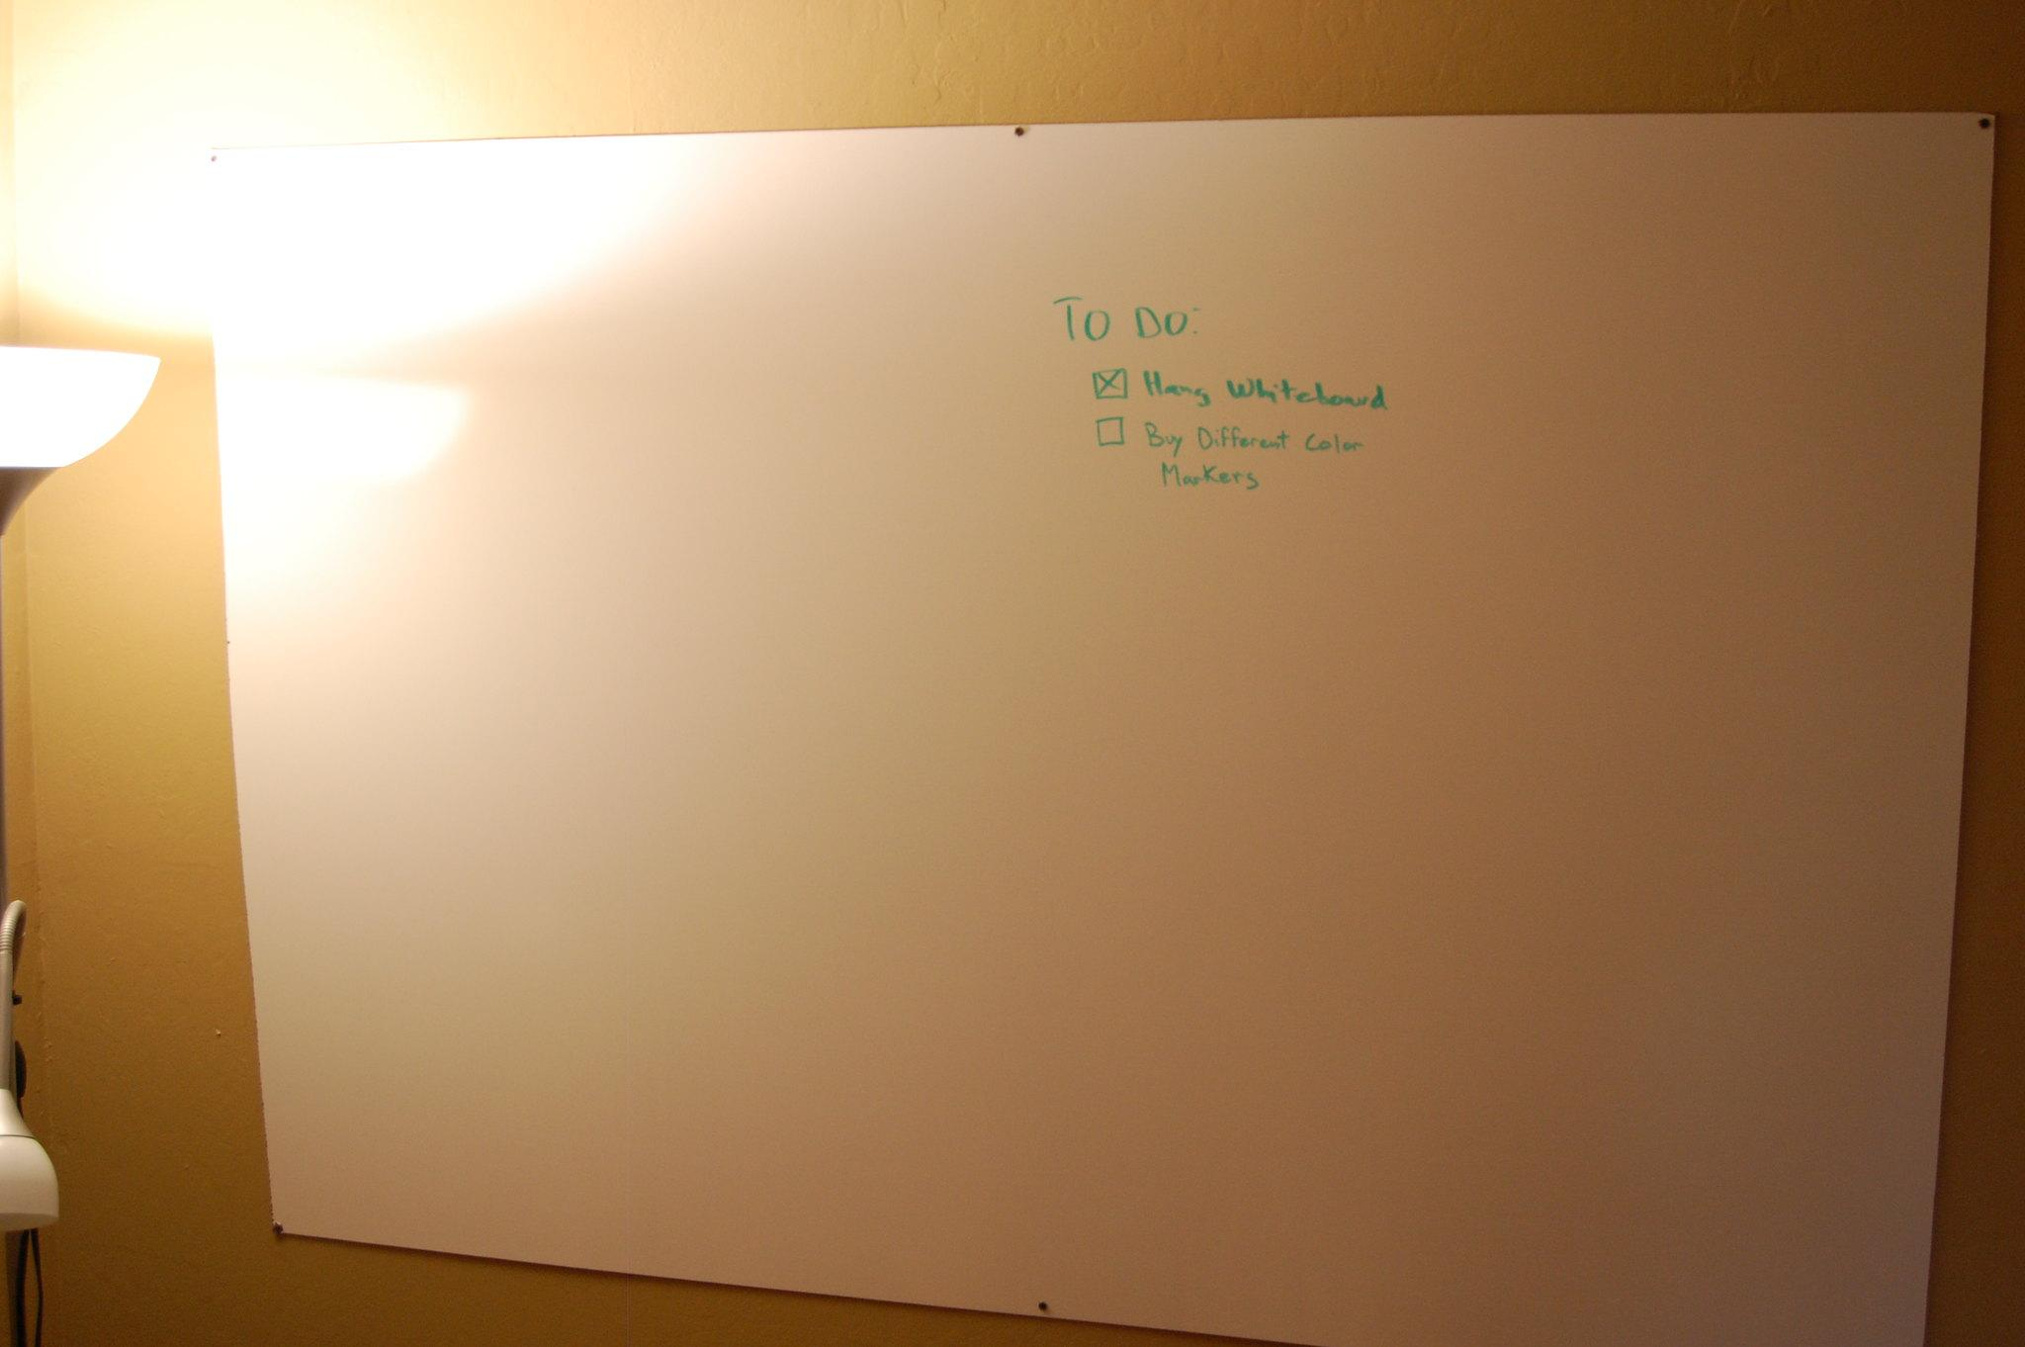
https://www.flickr.com/photos/32184125@N00/4310830876
Notes:
Time to get up and mingle to collaborate on challenges. Move to next slide for shared document based collaboration
(Hands on Activity) Interactive & collaborative Challenge design
For now we are going to collaborate on building challenges. The whole group will collaborate on one or two security question challenges and then break up into smaller groups to build more. Challenges must be solvable but keep in mind that players all have different levels of skill and knowledge. When designing challenges, keep in mind that you can and should provide hints that players can use to avoid quitting in frustration. First, pick a theme to focus on. Then remember: Relevancy, Appropriateness, Interesting/engaging, Solvable, Reflective. Hands on challenge building. Get up and move around.

Slide 32
Relevancy - challenges should use the same technologies and platforms that the participants work in
Appropriateness - challenges should cover vulnerability categories that are known to exist in the participants codebases
Interesting/Engaging - challenges should draw the participants attention and encourage them to find solutions
Solvable - challenges should have a clear and accurate solution
Reflective - challenges should reinforce targeted concepts
Red Flags - Avoid
Excessive Obscurity - solutions should be discoverable (with a reasonable amount of effort)
Non-Relevant - work to solve challenges should not be far outside of the participants skill set and work requirements
Open Ended - challenges should be have enough guidance to allow the participant to find an agreed upon “good” solution
Notes:
Take a few minutes and call out challenge ideas

Slide 33

https://www.flickr.com/photos/95380334@N04/8704970501
Notes:
Making it easy to participate: Enrollment
Depending on the audience this can include some friction but it should always be as easy as possible.
Differentiate TDX/DF from Security Essentials and other audience types (teens, etc.). Discuss planning out onboarding, player tooling requirements and tooling training

Slide 34
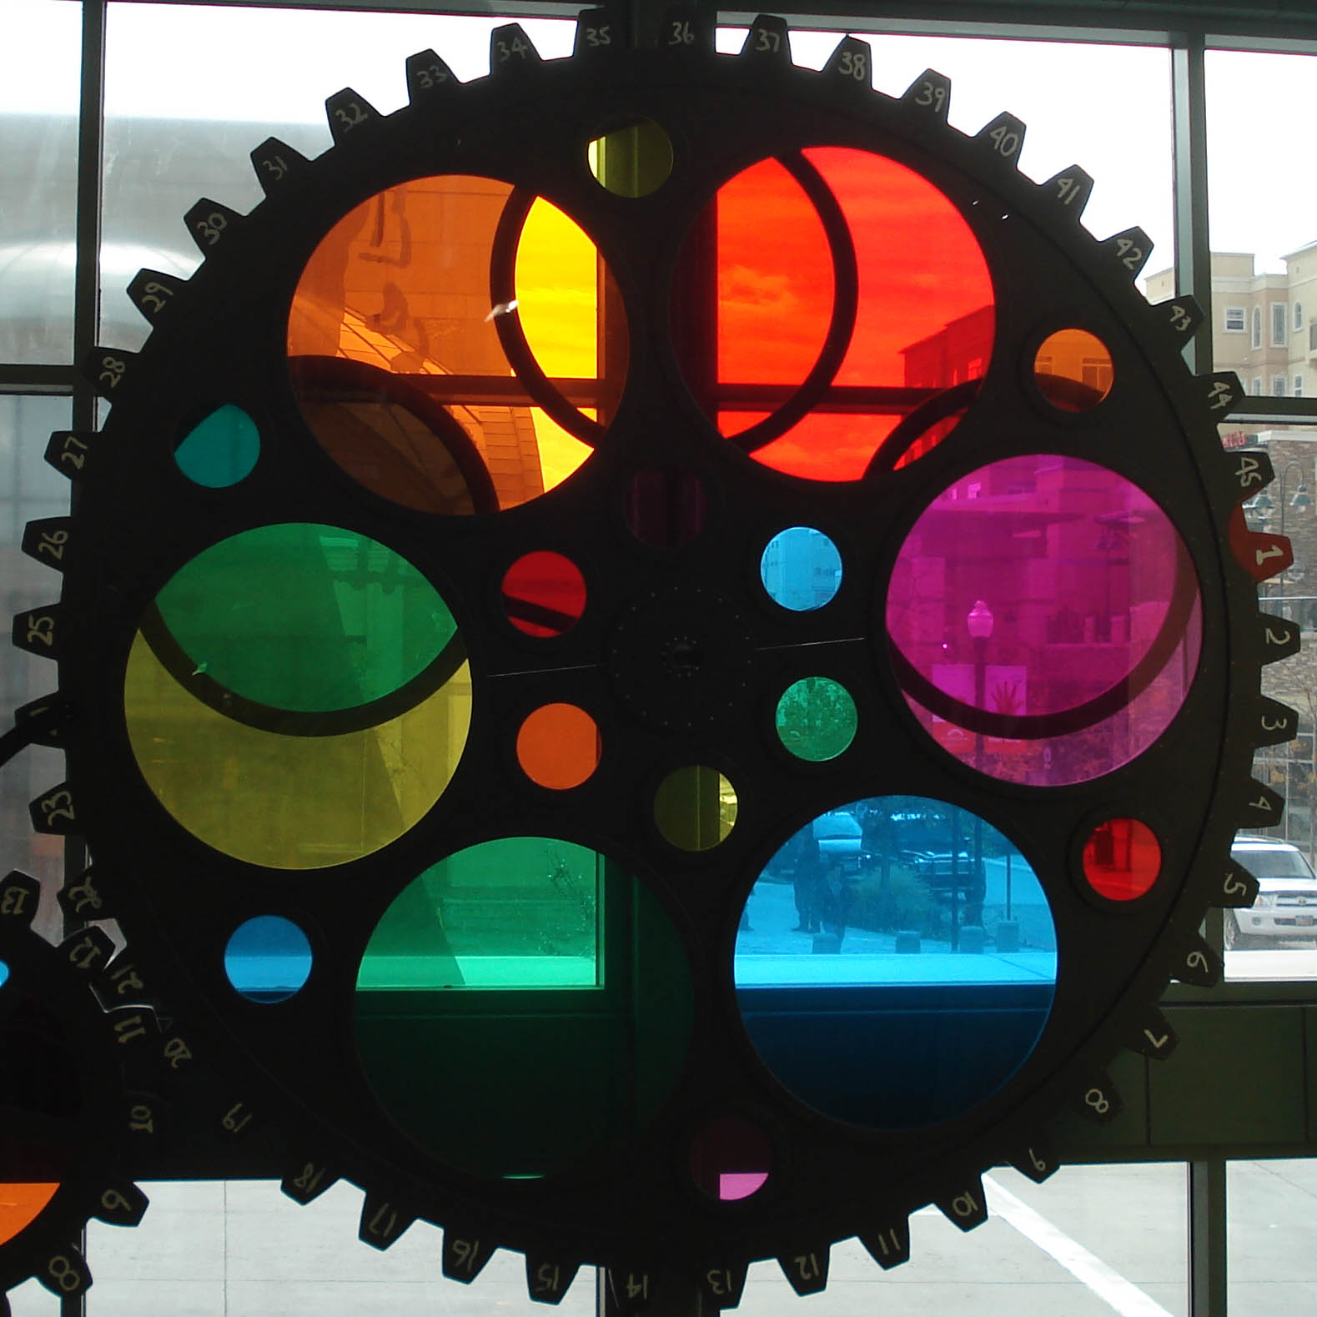
https://github.com/salesforce/integrated_challenge
https://www.flickr.com/photos/50318388@N00/304687602
Notes:
Making it easy to participate - Integration
Integration can improve results.
Salesforce API lent itself to integration and encourage discussion of other platforms/tools that could also benefit from a similar approach (AWS/Azure/GCP, Docker/K8s, SaaS)

Slide 35
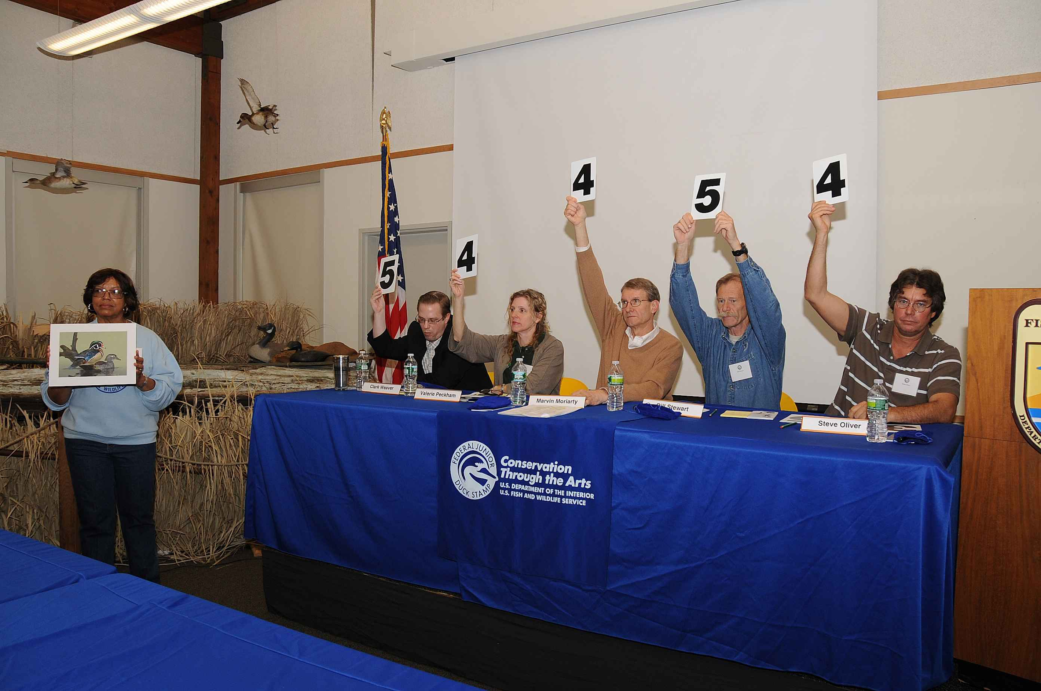
https://commons.wikimedia.org/wiki/File:Judges_hold_up_their_respective_scores.jpg
Notes:
Making it easy to participate - Scoring
Easy to participate means good, understandable scoring.
Think about goals that you want to accomplish and set the scoring appropriately.
want to maximize interaction so ensure that there are multiple ways to get on the board.
Think about how scoring will be structured to encourage more than just 1 top winner with the most points)
Open discussion of scoring ideas.

Slide 36

https://www.flickr.com/photos/144008357@N08/32943657843
Notes:
Making it fun
Get buy in early
Engage interest, get buy in and sponsorship from leadership early.
Show management good ROI and they will help.
Build a good case for what resources you will need, what time and money investments are required and the benefits that will come from it.
Work with groups of players to organize exclusive focused time to play. \
Think about how to include everyone, even remote players (TDX/DF players did not need to sit in the lab area and could work on challenges from anywhere).
Open discussion of good ideas to get and build interest.

Slide 37
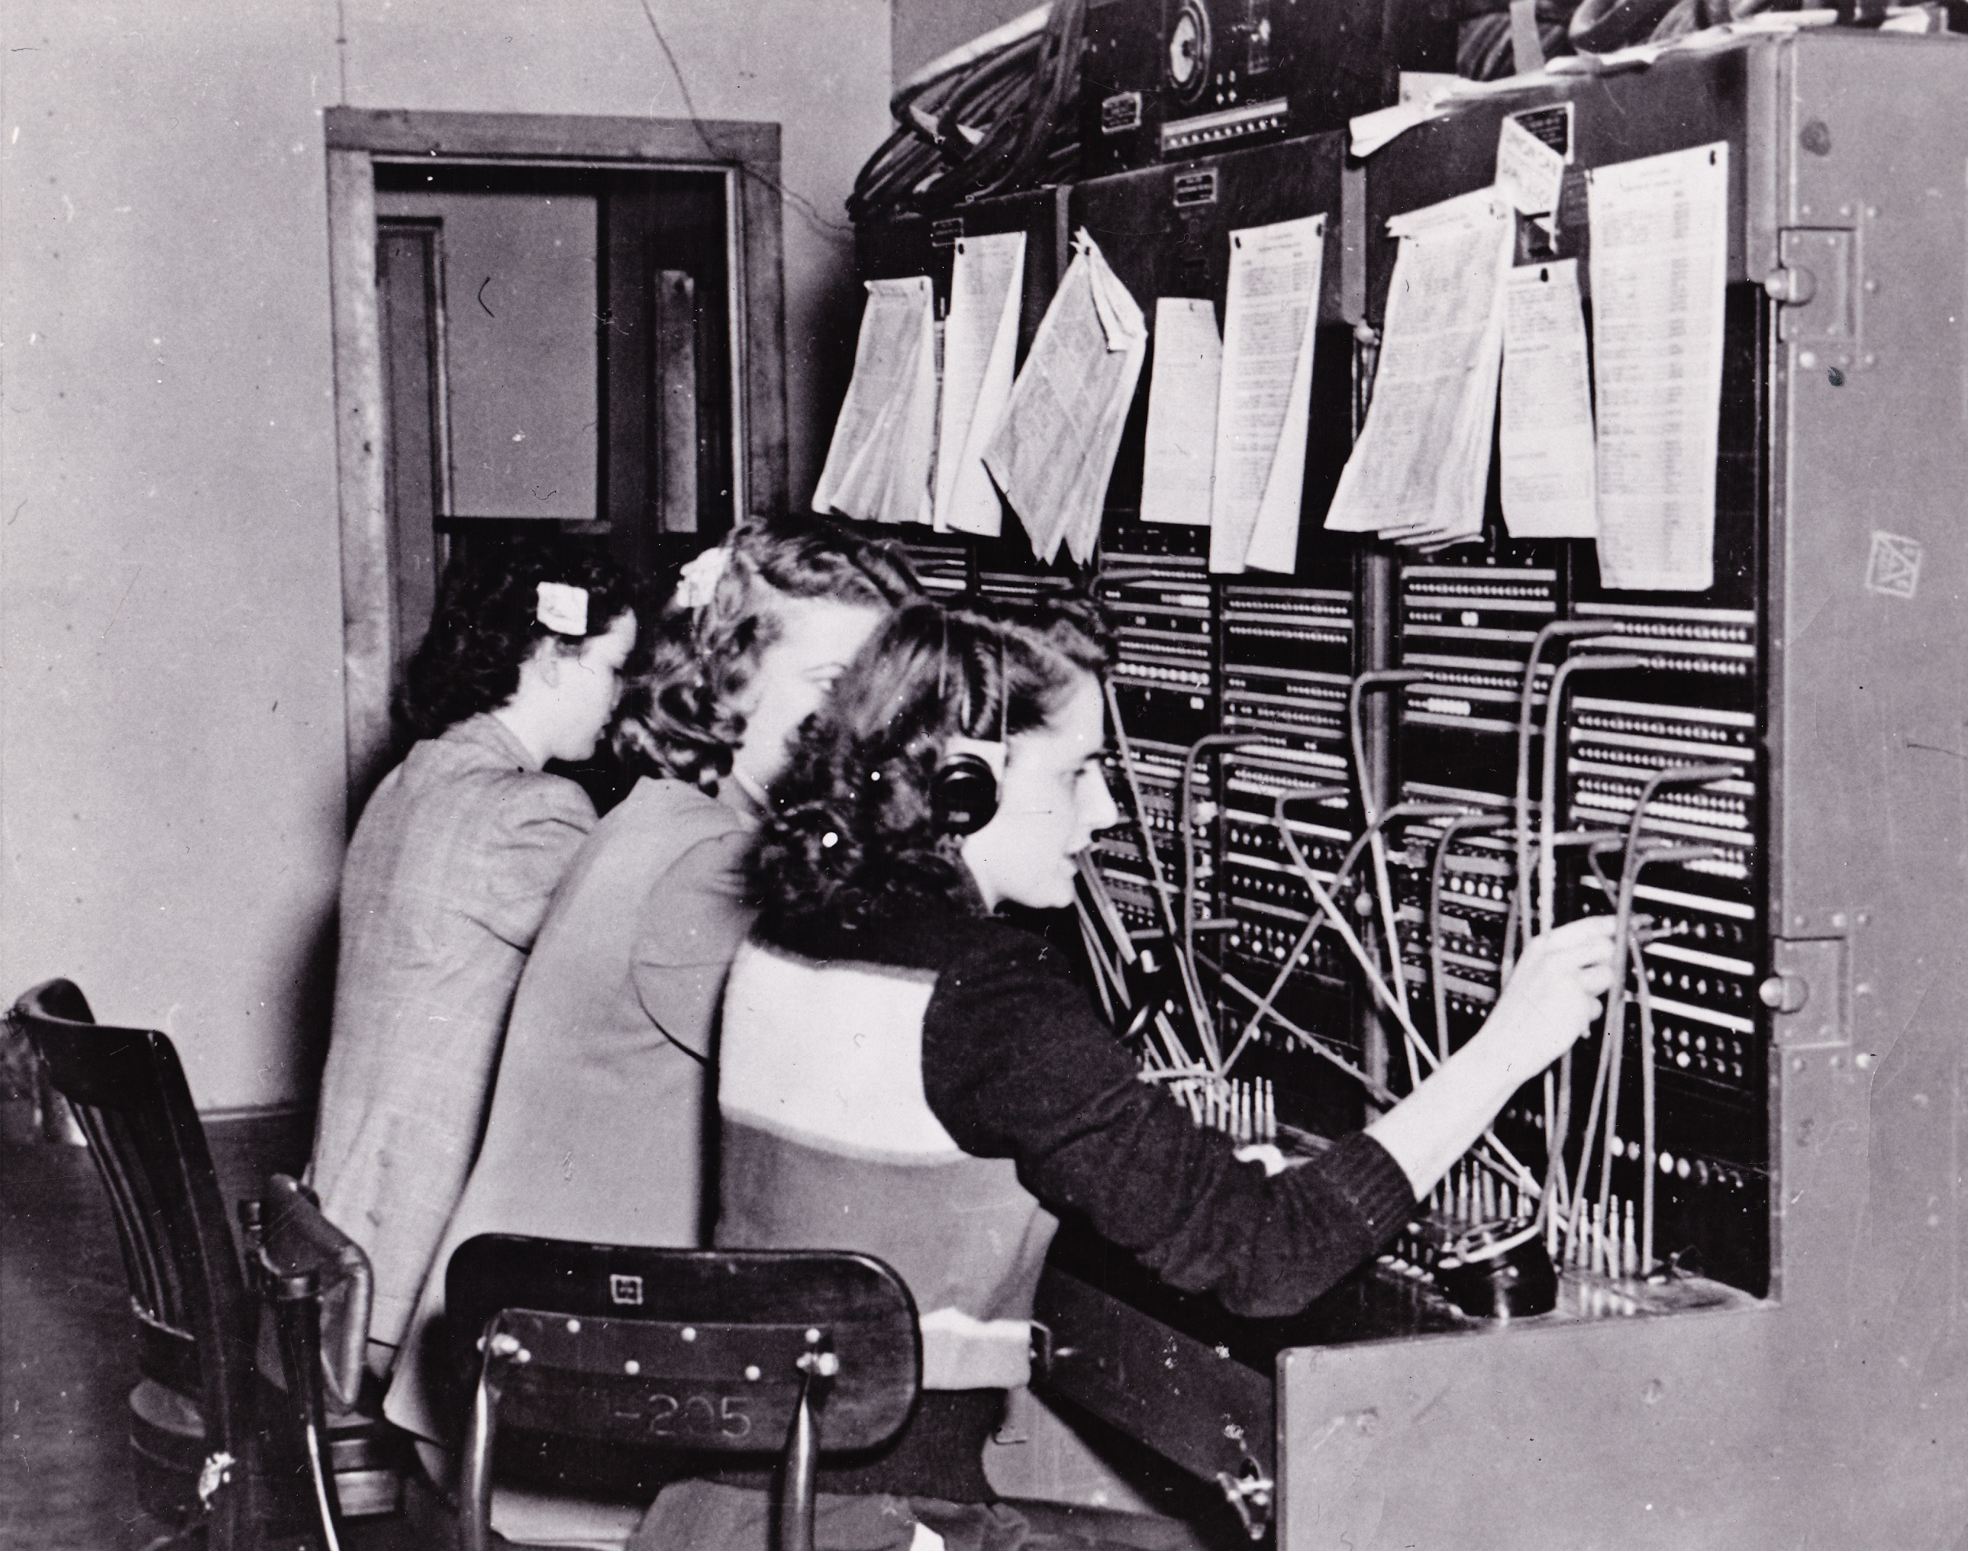
https://commons.wikimedia.org/wiki/File:JBER_telephone_operators_connect_calls,_people_120124-A-ZY202-001.jpg
Notes:
Making it fun - Communicate often
Communicate early, often and effectively.
Not just about the actual event bus also in the planning.
Involve security teams, engineering leadership and management in the planning to ensure that everyone's interests are represented and considered.
Encourage collaboration in building challenges.
Think about how you can publicize the event, before, during and after to raise awareness (and also encourage people who thrive on recognition).
Be open about the expectations and results. Open discussion of good communication ideas

Slide 38
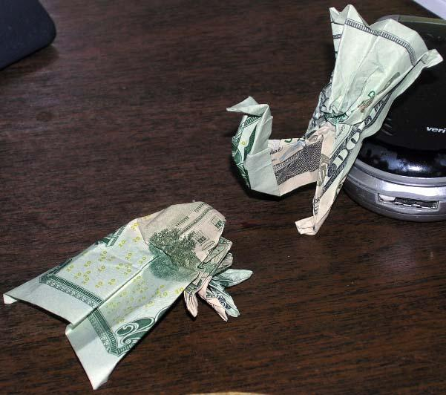
https://www.flickr.com/photos/23299838@N08/3350934724
Notes:
Making it fun - Incentives
Incentives - Competition is good but recognition also helps (not just seeing name on leaderboard, think about other incentives, discuss Trailhead badges and other swag).
Think about multiple levels of reward to encourage everyone to participate even if they will not be the one with the most points.
Open discussion of rewards.

Slide 39
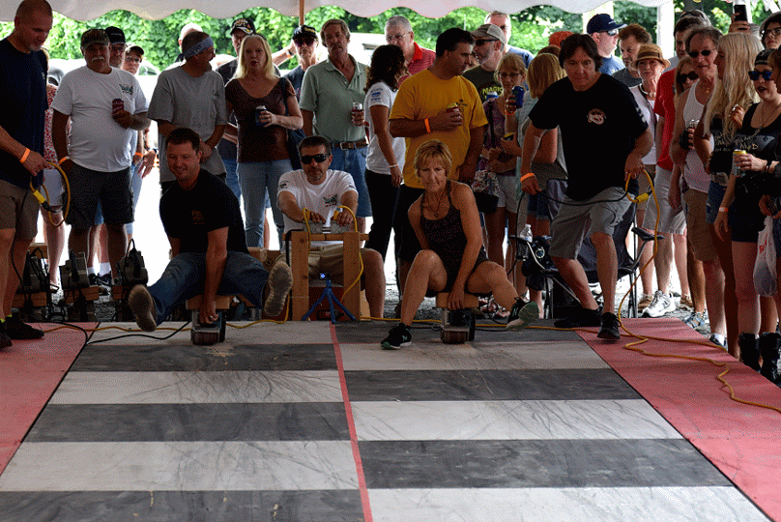
http://www.bertiesinn.com/beltsander_races/2017_beltsander_race.html
Notes:
Making it fun - Competitive - not bloodthirsty
Fun means fun for everyone. Remember that people are all different and have different motivations.
Some seek out public recognition and others avoid it.
CTFs usually require some amount of competitiveness but it all should be friendly, not bloodthirsty.
Collaboration should be encouraged, people work together to solve business problems, teamwork can be encouraged in the CTF (Codemash CTF example).
Attack & defend style may work in some cases but be considerate of pitfalls of aggressive competition.
Open discussion of ideas to encourage collaboration and fun, open discussion of different motivators and rewards

Slide 40
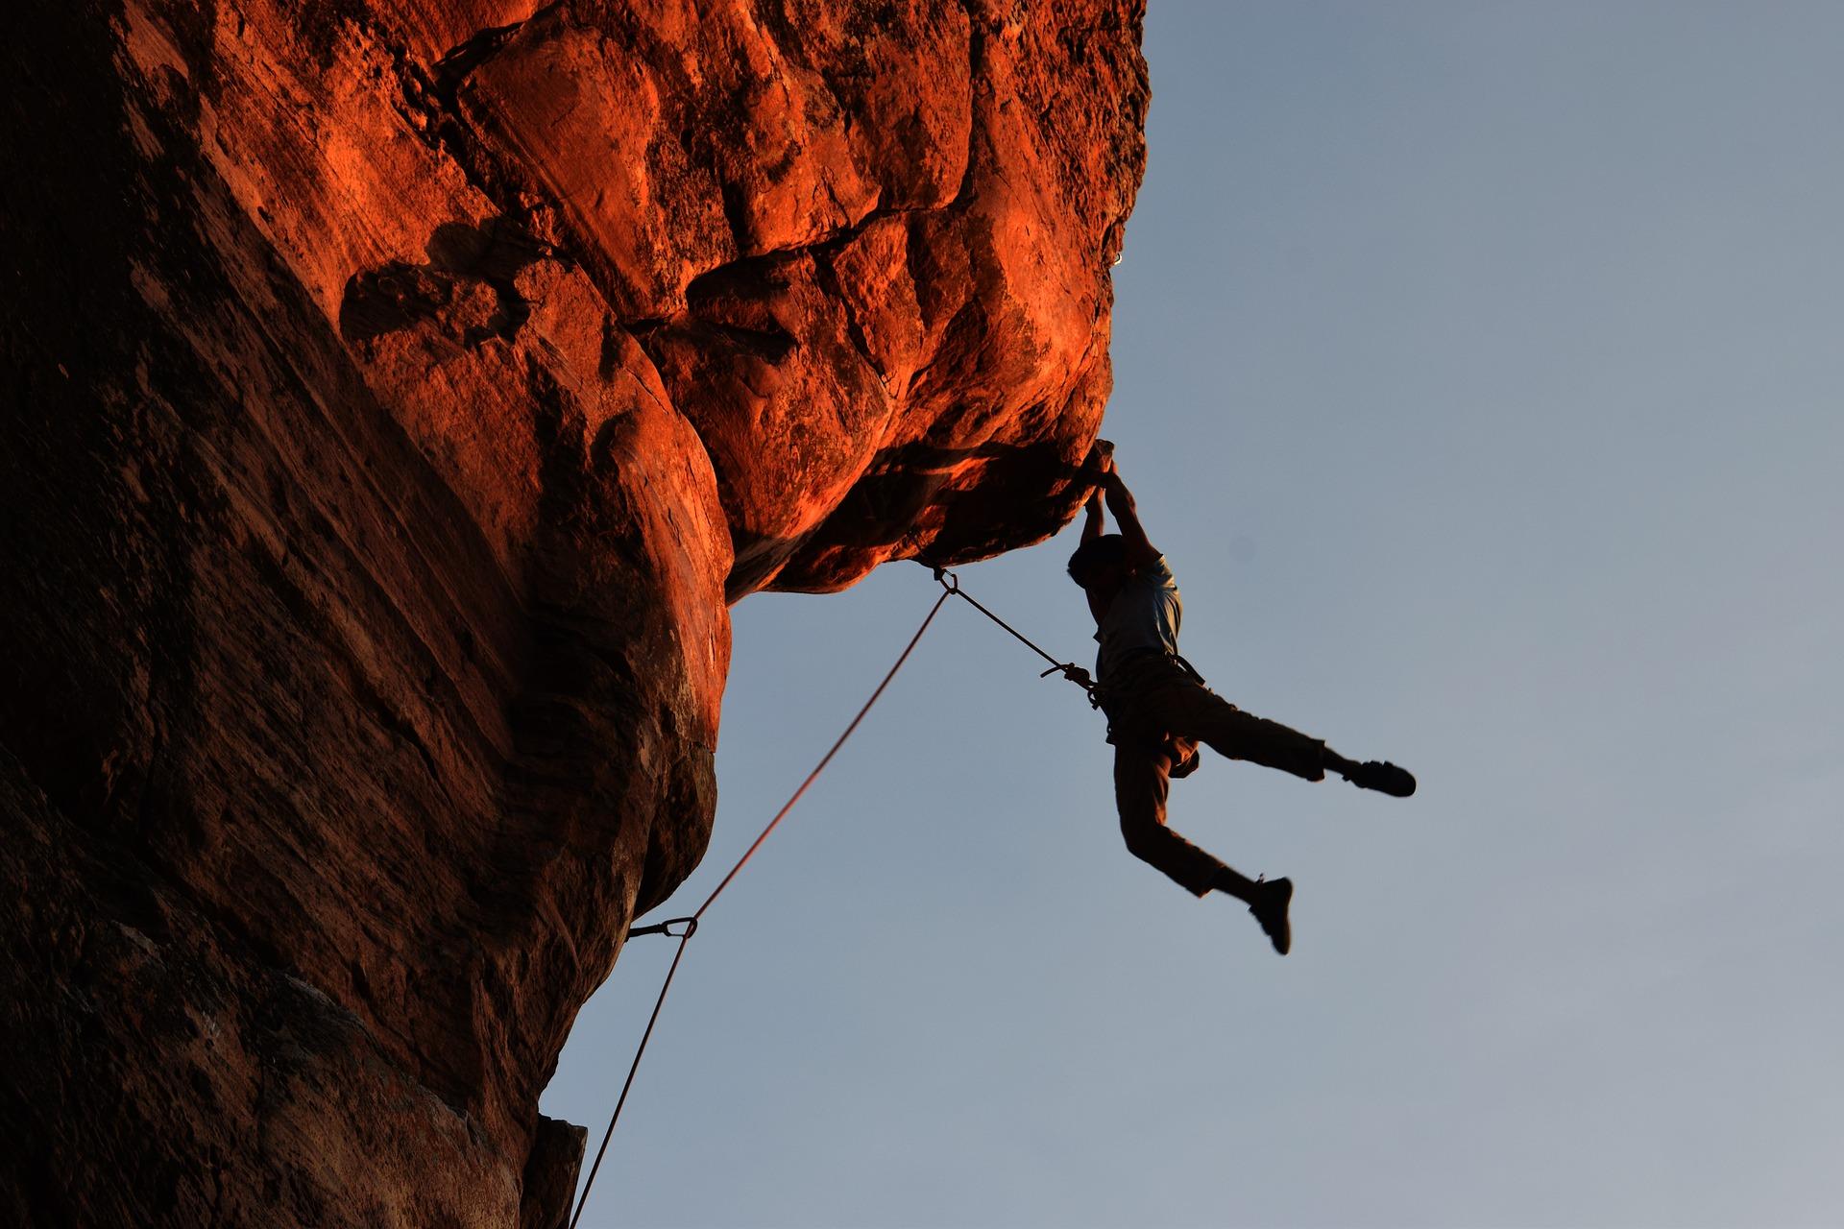
https://pixabay.com/photos/climbing-rock-climbing-overhang-2264698/
Notes:
Making it fun - Managing challenge difficulty
Making it fun also means managing challenge difficulty.
The challenges used in CTFs should vary based on the capabilities of the participants.
Focusing on a specific audience is essential.
Too broad, too easy, too complex are all ways to undermine the success of the CTF.
The end goal should be lasting internalized knowledge, not frustration

Slide 41
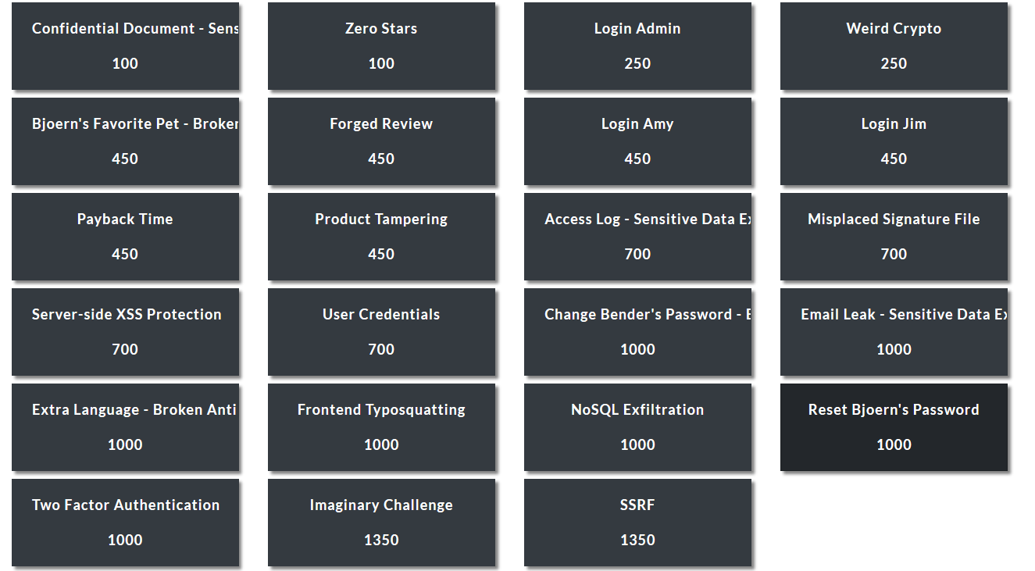
Notes:
Making it fun - Managing challenge difficulty versus rewards (points)
Points awarded should reflect the difficulty of challenges within the scope of your target audience.
Should be a good distribution of challenge difficulty, with higher difficulty resulting in more points awarded.
Encourage participation by providing a path of gradually increasing difficulty levels and remember that this is a knowledge transfer and retention device so make sure that it is not just a game of getting the most points.
Also, challenges do not need to be just technical but can involve collaboration with other teams, groups, departments and/or systems (story of SSDL SA and the Security Essentials challenge to create an SA)

Slide 42

https://pxhere.com/en/photo/1451207
Notes:
Making it fun - Follow ups - post event
The final consideration to make it fun is to follow up after the event.
Think of ways to build on the interest and success after the event is over.
Preplanning ways of sharing helps to build awareness, mindshare and interest.
Think of how you can use the buzz as feedback mechanism.
Include players in retrospectives to get their feedback on what worked well, what could be improved and what else they would like to see in future events.
Use the results to demonstrate your success to your investors.
Also think of how else you can use the results, such as identifying candidates for security champions. Since there is always a talent shortage in security you can even use this to poach engineers to join the security team.

Slide 43
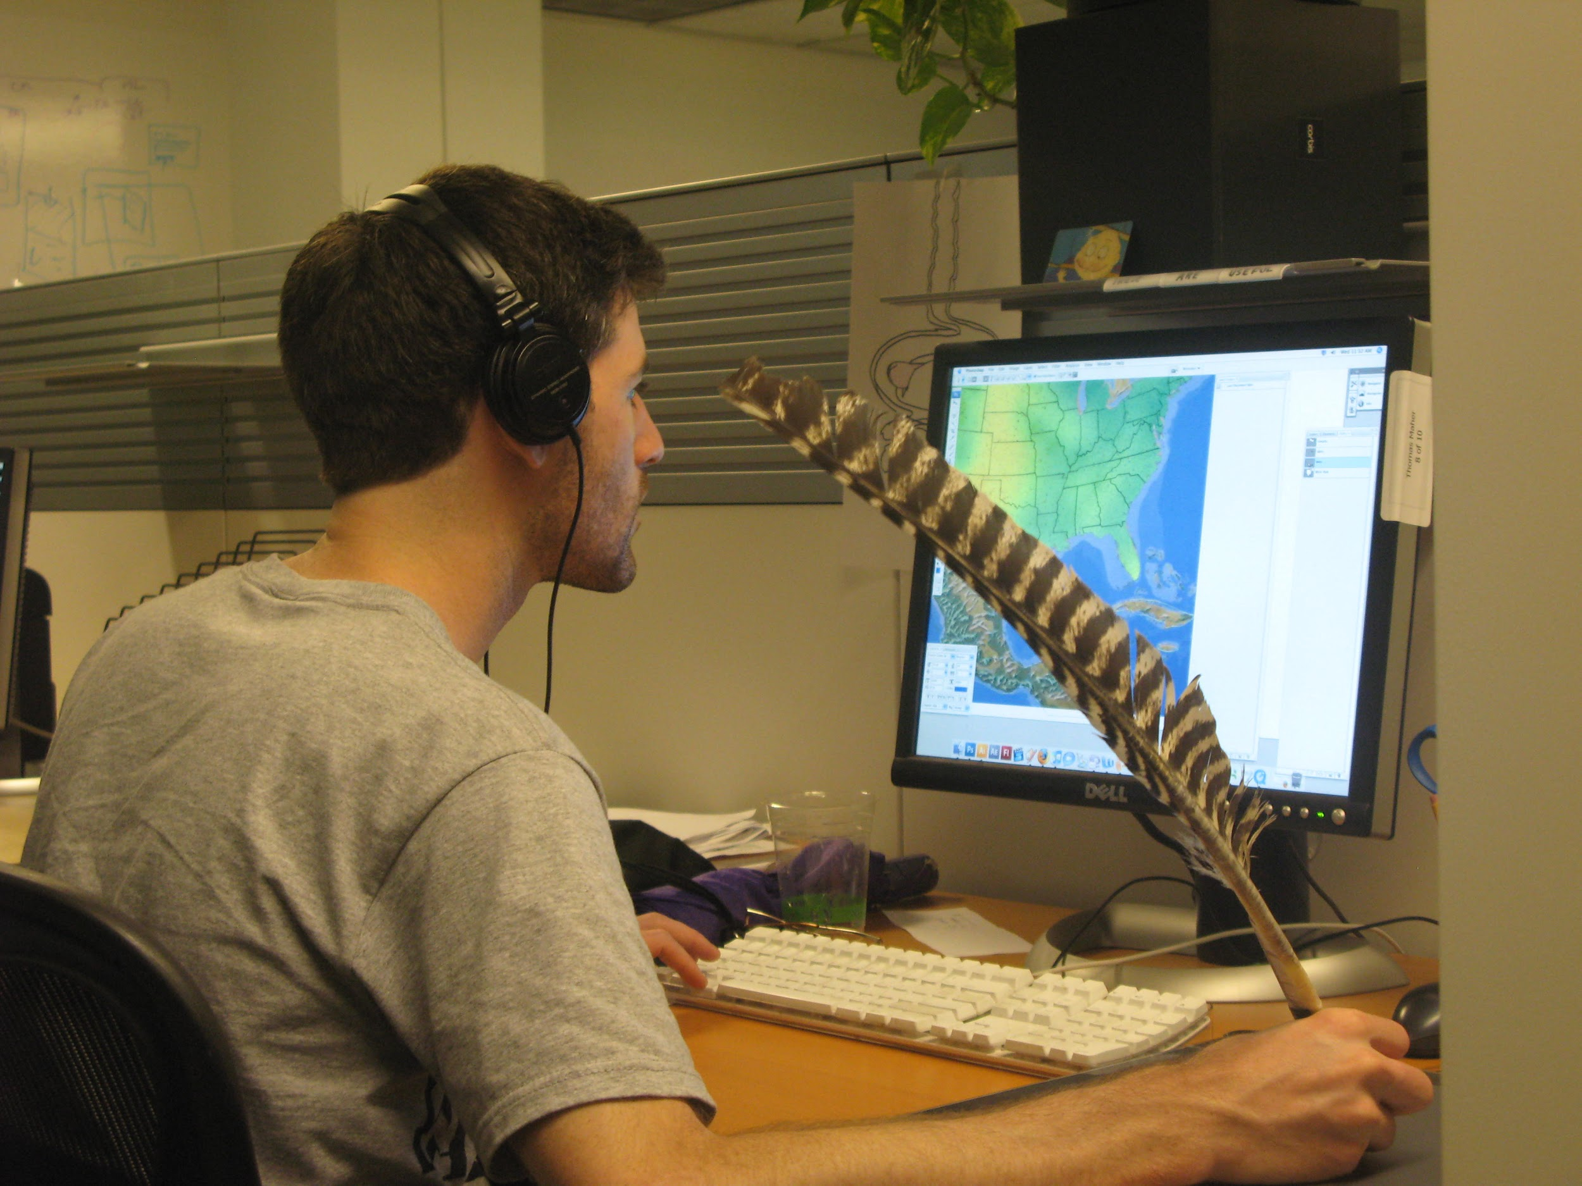
https://www.flickr.com/photos/pheezy/3769080979/
Notes:
Making it easy to run
Authoring
CTFs are not just all fun, they also require a good amount of effort all around.
already have more work than we can get to we are going to need to make this easy to run if we are going to be able to pull it off.
Minimizing effort and friction everywhere possible will allow you to build the best experience possible and iterate on it so that is is always fresh, exciting and relevant. The first challenge is authoring challenges. In our hands on activity we developed some challenges but we want to ensure that we have ways of building and collaborating on challenges that can scale and are as easy to use as possible. A CTF is only as good as its challenges are.
repetition is boring, our CTFs need to grow, change and evolve so we should be able to update easily.

Slide 44
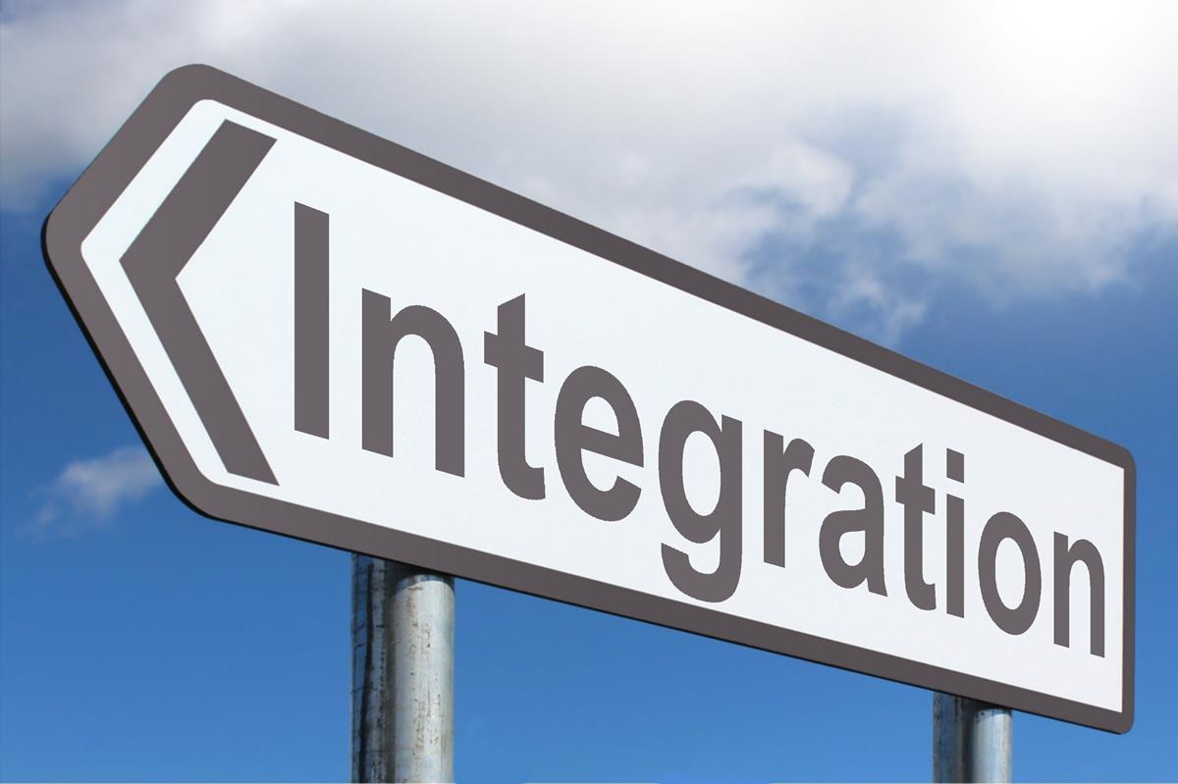
https://www.picpedia.org/highway-signs/i/integration.html
Notes:
Easy to run Integration
engage the players attention on the ideas required to solve the challenges and learn the material, so we want to reduce the amount of non-essential work we ask of them.
tight integrations can be beneficial by reducing overhead and allowing players to focus on the goal.
Integrations can also provide a richer environment and broader scope.
Poll the room about Juice Shop and talk about its CTF mode.

Slide 45
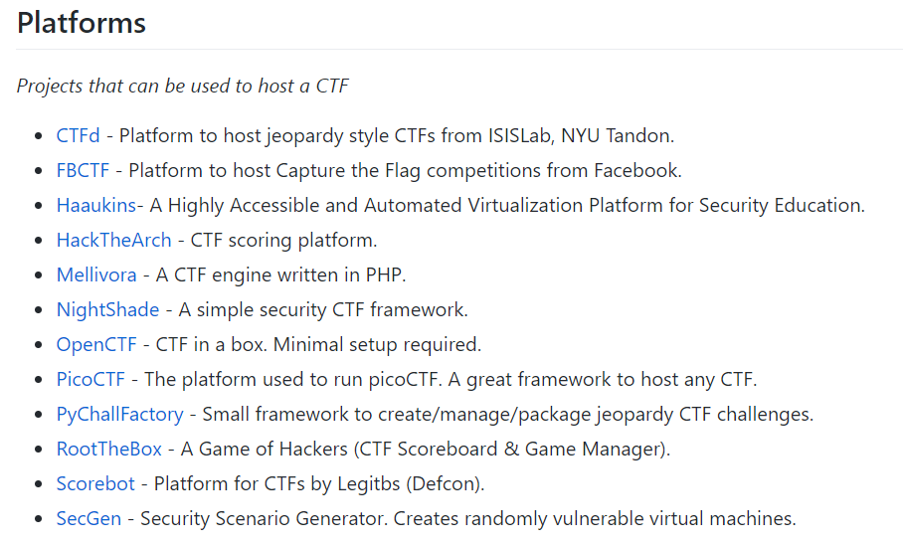
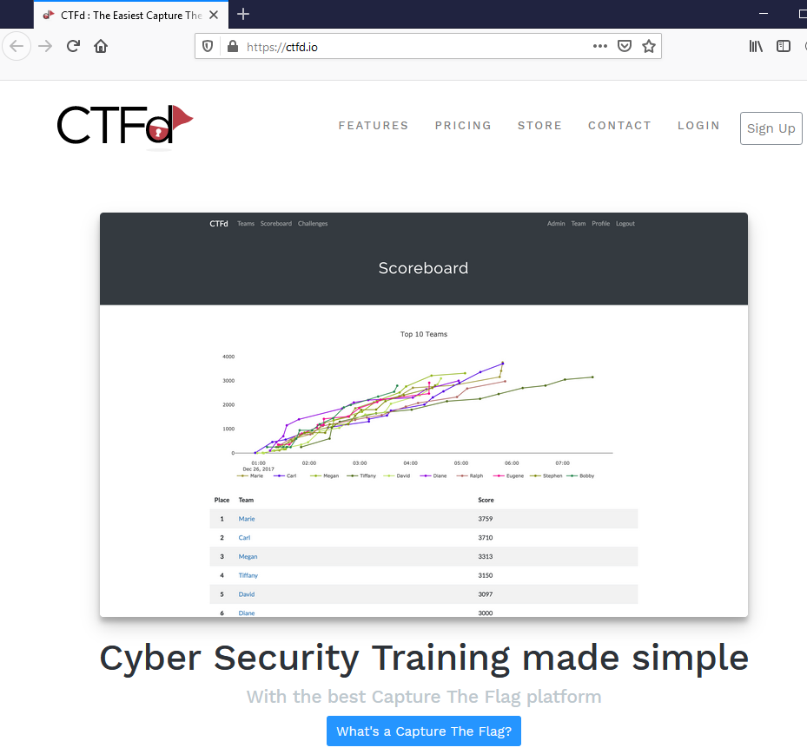
https://github.com/apsdehal/awesome-ctf
Notes:
Easy to run Hosting

Slide 46
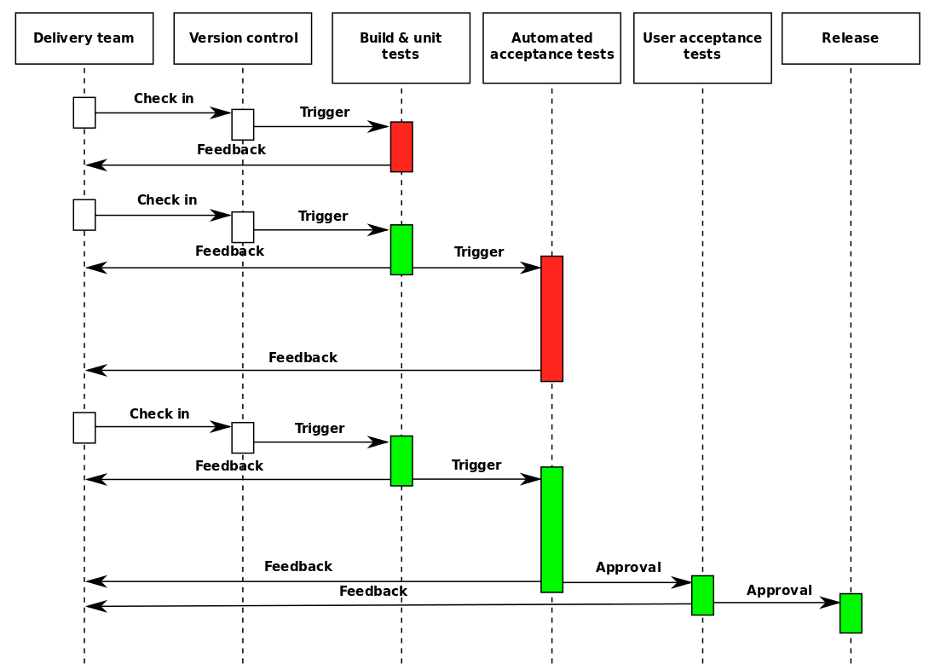
https://commons.wikimedia.org/wiki/File:Continuous_Delivery_process_diagram.svg
Notes:
Easy to run Deployment
Minimizing friction also means automating repetitive tasks. CI/CD can help by enabling rapid iteration as well as ensuring consistent, repeatable environments.
Discuss benefits of CI/CD, having multiple environments and supporting multiple CTF instances with different focuses and challenge sets

Slide 47
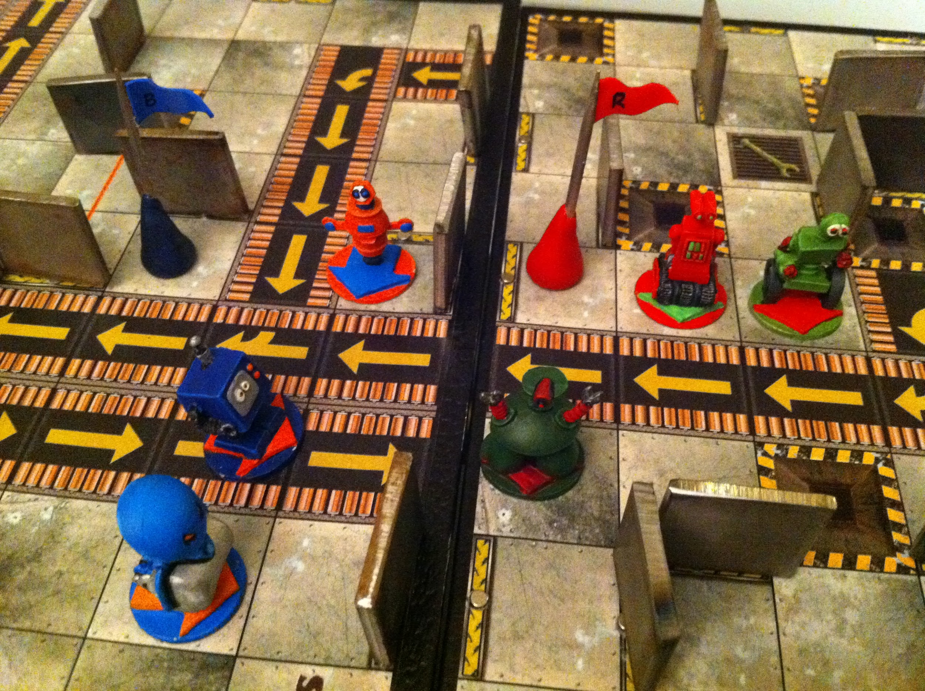
https://www.flickr.com/photos/mknowles/5358317992
Notes:
Easy to run Execution
Repeatable CTFs in stable environments allow you to achieve repeated successes with minimal effort.
Make sure your CTF environment is aligned with your policies and requirements.
Expose your environments only as much as makes sense.
Keep in mind what information you are exposing in your CTF and control access appropriately.

Slide 48







Notes:
Now on to the How
Tools used for this session
CTFd
Heroku/AWS
Node.js
Custom code
Docker (optional)

Slide 49
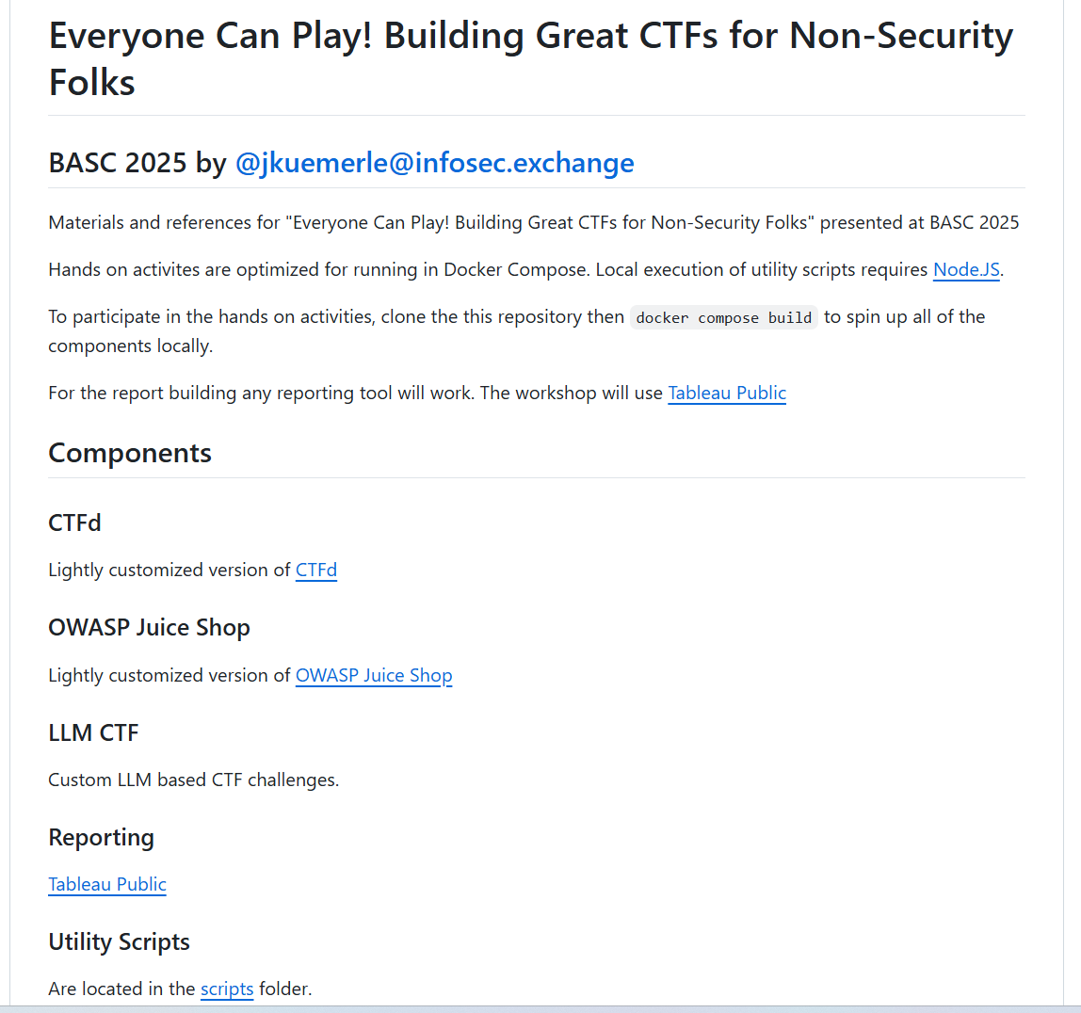
https://github.com/jkuemerle/basc2025
Notes:
Here are some possible utilities to help build a repeatable process

Slide 50
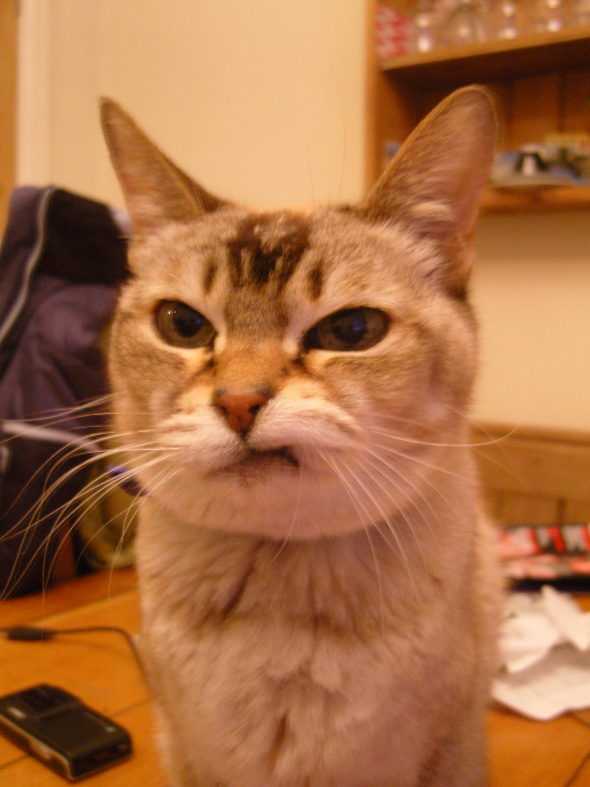
https://www.flickr.com/photos/24886284@N00/3248529556
Notes:
Demo editing/building here
Be sure to point out the CTFd import customization

Slide 51

https://pxhere.com/en/photo/1437973
Notes:
Now that we have an easy to run environment we also want to make sure that we use it effectively.
CTF is not just for having fun, we want to adhere to our goal of using learning principles to effectively teach our players valuable skills and increase their retention of those skills.
Metrics and measurements will help us to demonstrate our success.

Slide 52
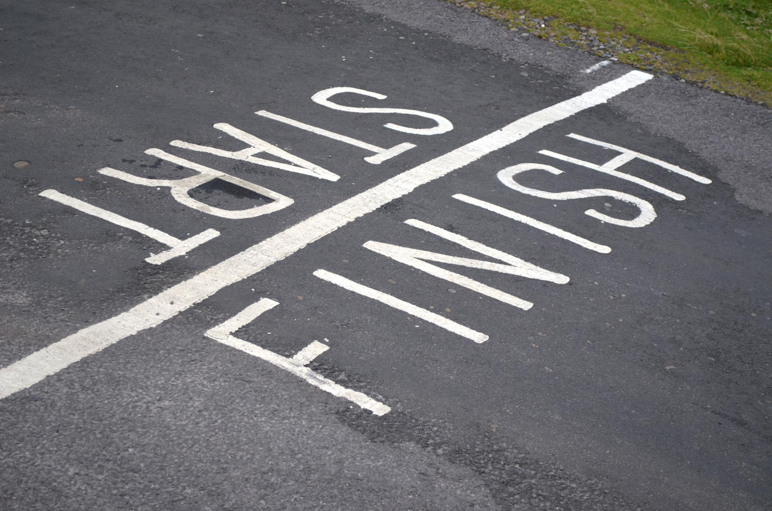
https://www.flickr.com/photos/andrewhurley/6254409229
Notes:
Effectiveness Post event measurements
We discussed earlier how we can keep communicating after the event is over to help build ongoing involvement and iterate.
Running one successful event should lead to a desire to run more.
As many of us know, once you play a CTF you usually want to play another one.
Take feedback,follow up with players, update and evolve challenges will take you from the finish line of your first event to the starting line of your next

Slide 53

https://www.flickr.com/photos/70267096@N00/8234628909
Notes:
How to communicate results? Dashboards!
Effectiveness Communicating results

Slide 54
https://engineering.salesforce.com/play-games-learn-better-fc782757c884
Notes:
Dashboard

Slide 55
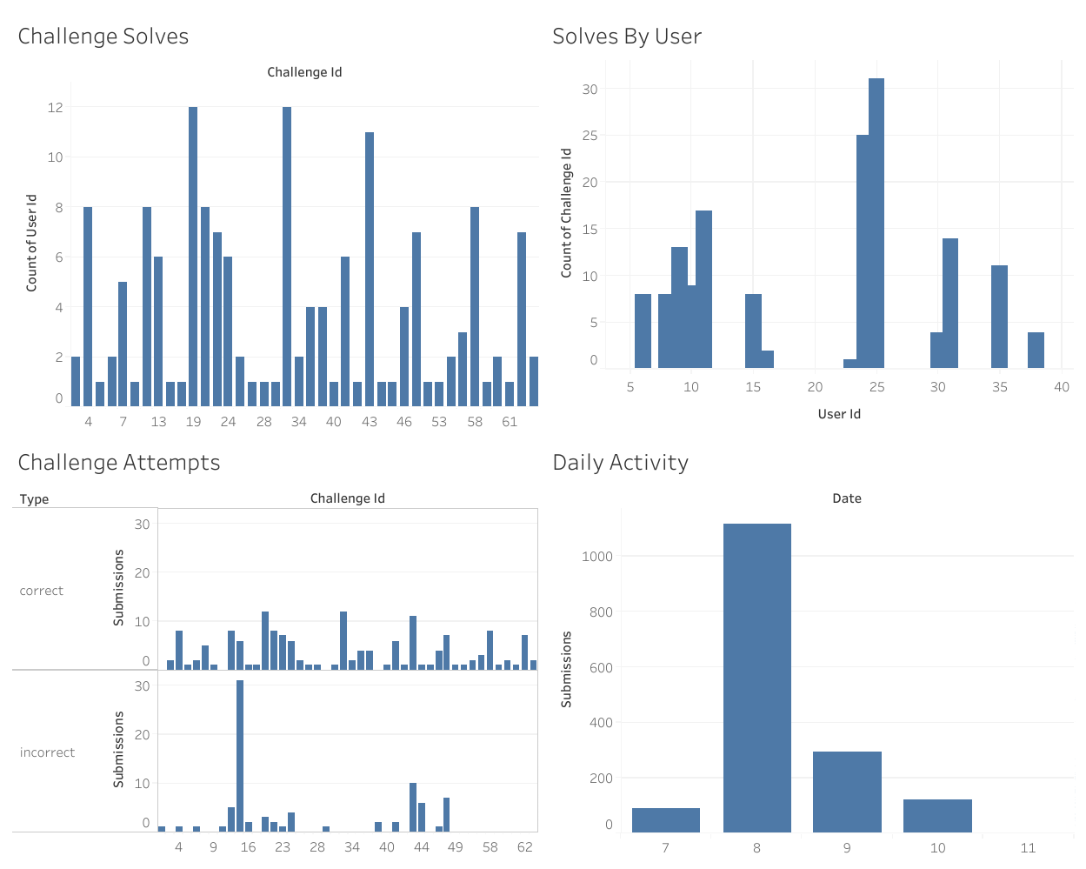

ctf/CTF_Data/results
CTF-Challenges.csv
CTF-solves.csv
CTF-submissions.csv
CTF-users.csv
https://bit.ly/BASC-CTF-Dashboard
Notes:
Tableau reports here

Slide 56
Other Vulnerable Things
https://yieldcat.com - Vulnerable web app
https://github.com/step-security/github-actions-goat - Deliberately Vulnerable GitHub Actions CI/CD Environment
https://github.com/RhinoSecurityLabs/cloudgoat - "Vulnerable by Design" AWS deployment tool.
https://github.com/ine-labs/AzureGoat - A Damn Vulnerable Azure Infrastructure
https://github.com/ine-labs/AWSGoat - A Damn Vulnerable AWS Infrastructure
https://github.com/vavkamil/awesome-vulnerable-apps
Notes:
Other vulnerable systems/applications

Slide 57
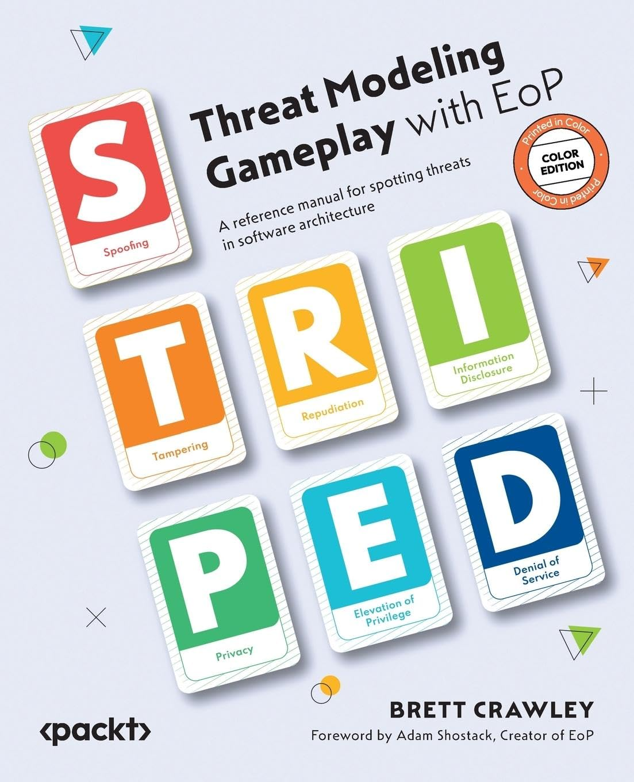
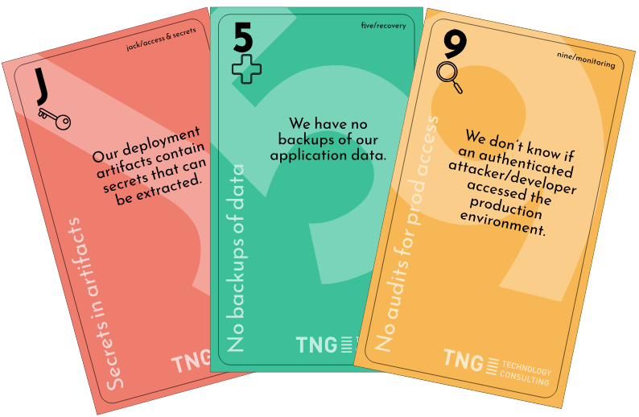
https://github.com/adamshostack/eop
localhost:8360
ctf/BASCThreatDragonModel.json
https://github.com/TNG/cumulus
Notes:
Other gamified security stuff: Threat Modeling games: Elevation of Privilege, Cumulus
http://localhost:8360

Slide 58
Conclusion
Why
What
How
|
‹#›
Notes:
Conclusion
Why:
incorporate formalized learning principles
SF successes (engagement time and number of challenges),
increase security knowledge, keep it top of mind
improve retention of concepts
What:
audience considerations,
challenge [relevancy, appropriateness, interesting/engaging, solvable, reflective],
red flags [obscurity, non-relevant, open ended],
collaborative challenge building techniques,
making it easy to enroll,
easy to use,
making it fun by communicating early and often,
appropriate incentives,
friendly competition, and
following up.
Making it easy to run with easy challenge collaboration,
good integrations,
reusable pipeline
consistent deployment.
Making it effective with good measurements and metrics,
iterative processes to improve future CTFs and
clearly communicating results
How:
Building challenges,
automating build and deployment,
hosting and access control,
enhancing the experience with custom capabilities,
building dashboards
implementing self provisioning

Slide 59
Next Steps
Next week you should:
Identify teams that will benefit from CTF style training
Identify SMEs to build a pilot CTF
In the first three months following this presentation you should:
Have run a CTF and iterated on the design, challenges and goals
Run retrospectives of both CTF builders and CTF players
Gathered usage data into a repository
Within six months you should:
Have an active, ongoing CTF based training program
Run regular retrospectives and incorporate feedback
Report KPIs and regularly survey program effectiveness
|
‹#›
Notes:
Conclusion
Why:
incorporate formalized learning principles
SF successes (engagement time and number of challenges),
increase security knowledge, keep it top of mind
improve retention of concepts
What:
audience considerations,
challenge [relevancy, appropriateness, interesting/engaging, solvable, reflective],
red flags [obscurity, non-relevant, open ended],
collaborative challenge building techniques,
making it easy to enroll,
easy to use,
making it fun by communicating early and often,
appropriate incentives,
friendly competition, and
following up.
Making it easy to run with easy challenge collaboration,
good integrations,
reusable pipeline
consistent deployment.
Making it effective with good measurements and metrics,
iterative processes to improve future CTFs and
clearly communicating results
How:
Building challenges,
automating build and deployment,
hosting and access control,
enhancing the experience with custom capabilities,
building dashboards
implementing self provisioning

Slide 60

Resources
https://github.com/salesforce/integrated_challenge
https://github.com/apsdehal/awesome-ctf
https://www.cisco.com/c/dam/en_us/solutions/industries/docs/education/Multimodal-Learning-Through-Media.pdf
https://engineering.salesforce.com/capture-the-flag-secure-your-knowledge-37b43180e55a
https://engineering.salesforce.com/play-games-learn-better-fc782757c884
https://github.com/CTFd/CTFd
https://github.com/SamuraiWTF/samuraiwtf
https://github.com/jkuemerle/basc2025
https://www.flickr.com/photos/88547796@N00/5716815256
Notes:
Resources
Samurai WTF to provision Juice Shop and tooling (ZAP, SQLMap, etc)

Slide 61
ADDRESS
401 Edgewater Place, Suite 600 Wakefield, MA 01880
THANK YOU
PHONE
+1 951-692-7703
FOR YOUR ATTENTION
E-MAIL
contact@owasp.org

